Slide 1
Was That CT? Assessing Computational Thinking Patterns through Video-Based Prompts
Krista Sekeres Marshall
University of Colorado, Boulder

Slide 2
Something about me
Luna Xu (徐璐娜)
Ph.D., Computer Science, Virginia Tech
  Advisor: Dr. Ali R. Butt
M.Eng., Computer Engineering and Science, Shanghai University
B.Eng., Computer Engineering and Science, Shanghai University

Slide 3
Computational Thinking Pattern
There is a real need to move beyond definitions and into operationalizing (LeCompte & Schensul, 1999, p. 153) computational thinking so that it is understandable, observable and measureable
Instead of defining CT, we should concretely define what we expect students to learn
Therefore, Computational Thinking Pattern (CTP) have been defined.

Slide 4
CTP (cont.)
Recognizing Computational Thinking Patterns (Basawapatna, Koh et. al.)
  Collision
  Transportation
  Generation/Absorption
  Diffusion
  Hill Climbing
STEM simulation
  Transformation
  Proximity
  Percent Chance
From students
  Movement
  Strategy
  Design

Slide 5
Teaching
Games/ Simulations | Computational Thinking Patterns
Frogger | Generation, Absorption, Collision, Transportation, Movement*, Strategy*, Design*
Pac-Man | Absorption, Collision, Diffusion, Hill Climbing, Movement*
Sims | Multiple Diffusions, Hill Climbing
Contagion Spread Simulation | Random Movement*, Transformation*, Proximity*, Percent Chance*
Forest Fire Simulation | Transformation*, Proximity*, Percent Chance*
Table 1 Games/ Simulations and corresponding Computational Thinking Patterns (adapted from Basawapatna, Koh, & Repenning, 2010)

Slide 6
Measuring transfer
Measures of transfer often show different results than those that measure only recall.
“Instructional differences become more apparent when evaluated from the perspective of how well the learning transfers to new problems and settings” (National Research Council, 2000, p. 77).
When teaching students computational thinking skills, evidence of transfer to focus areas in K-12 education (often math, literacy and science) is of importance to the use and sustainability of the curriculum.
CTP Video-Prompt Survey

Slide 7
CTP Video-Prompt Survey
Michael Crotty (1998), “…the view that all knowledge… is contingent upon human practices, being constructed in and out of interaction between human beings and their world, and developed and transmitted within an essentially social context” (p. 42).

Slide 8
Method
Over 500 middle school students
Fall 2010 semester at the end of the AgentSheet unit
AgentSheet as part of the coursework / using AgentSheet as a part a statistics unit in a mathematics class
A pilot version of the CTP Video-Prompt Survey was also given to teachers and community college students during the 2010 Scalable Game Design Summer Institute

Slide 9
Method (cont.)
Participants were also asked to complete pre and post motivation surveys and individual interviews were conducted with teachers and select students
Directly named any of the patterns/ described the pattern in other words with the same meaning

Slide 10
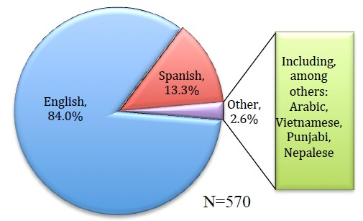
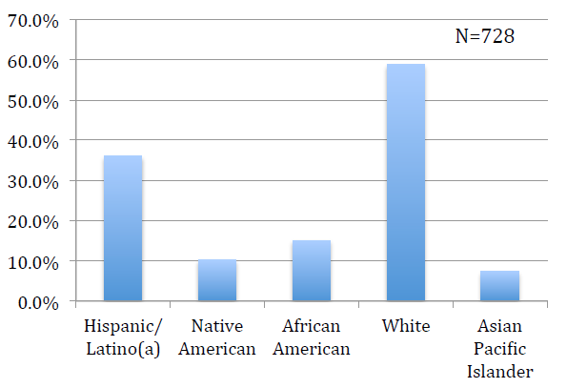
Sample Diversity
Chart 1: Respondents’ Primary language Spoken at Home
Chart 2: Respondents’ Races/Ethnicities

Slide 11
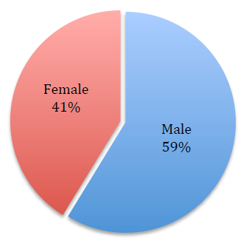
Grade | Percent | Number
4th | 0.4% | 2
5th | 2.4% | 13
6th | 31.8% | 181
7th | 26.3% | 150
8th | 35.4% | 202
9th | 0.2% | 1
10th | 3.7% | 21
N=570
Chart 3: Respondents’ Genders
Table 2: Respondents by grade level

Slide 12
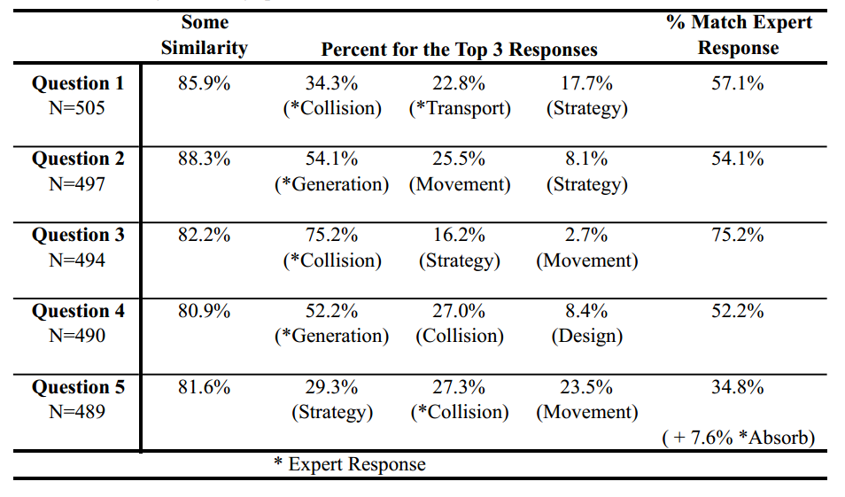
Results by Question
Table 3: Survey results by question

Slide 13
Questions
Question 1: the video depicts a flying eagle catching a fish, representing the CTPs collision and transport as the “expert responses”.
Question 2: the video shows a marching band coming out of tunnel, which is similar to the generation Computational Thinking Pattern.
Question 3: the video depicts two Sumo wrestlers engaging in match, representing the CTP collision as the “expert response”.
Question 4: the video shows a Press-dough toy squishing out dough into various shapes – generation
Question 5: the video depicts a man bowling over a chair, representing the CTPs collision and absorption as the “expert responses”.

Slide 14
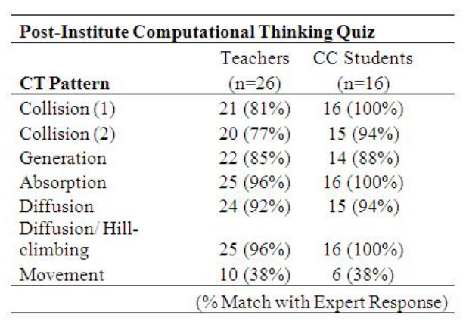
Pilot results
Table 4. Identification of CTPs in Video Clips

Slide 15
Some things to notice
Variety and creation
Difference from the researchers and students
Actor-oriented view
  When using actor-oriented views of transfer, transfer is seen as “the generalization of learning” rather than the “formation of particular, highly valued generalizations” often used in classical transfer approaches (Lobato, 2008, p. 171).

Slide 16
Conclusion
The CTP Video-Prompt Survey aims to assess skills that students can put to use in a variety of situations, including STEM simulations and areas beyond formal learning environments
By utilizing video prompts of real-life events and relating these to CTPs used in computing, we can assess what students know about these patterns and the extent to which this knowledge can be used to model realistic situations
As an estimated 1000 additional students will respond to the CTP Video-Prompt Survey during the current Spring 2011 semester
Recursive analysis of the patterns emerging from student responses will give us more information on the usefulness of the CTPs

Slide 17
Some thoughts
Is CTP what we want our students to learn?
Expert responses?
How to fill the gap in between?
Pros:
  Concretely define what skills students will be working to master
  Recursive analysis of the patterns emerging from student responses (creativity)

Slide 18
Problem Solving in CS
Heuristics List
  Go to extremes: Often the "ends" of the problem are important special features.
  Simplify: Try the problem on small cases to gain understanding.
  Visualize: Use appropriate representations (diagrams, tables, etc.) for information to help organize.
  Look for symmetries and invariants: These might be special features of importance, or they might give additional insight into the problem.
  ….

Slide 19
Thank You!

