Slide 1
New Papers and Websites

Slide 2
SIGCSE 2012 Keynote Address
The Teacher’s Job is to Design Learning
Experiences;
Not Primarily to Impart Information
Frederick P. Brooks, Jr.

Slide 3
SIGCSE Session: Video/Visualization
Session on videos and visualization in CS courses – Mostly, traditional distance learning (videos of classroom lectures)

Slide 4
SIGCSE Sessions: Active Learning (1)
“Flipped classroom” model for CS1: KA-style screencasts prior to class, mini-lectures as-needed, and in-class group exercises
Just in Time Teaching (JiTT) for a database course: Students do readings and fill out a survey/questions to gauge learning. Then mini-lecture given as needed to fill in the next day.

Slide 5
SIGCSE Sessions: Active Learning (2)
Process Oriented Guided Inquiry Learning (POGIL) for Computer Science
Small teams working on guided learning activities.
Students take defined roles (manager, speaker, recorder)
Ex: Stacks and queues
They get a series of questions to answer on the topic, that involves discussion and maybe research
There was also a Special Session on POGIL

Slide 6
Science Article on learning
J.A. Kaminski, V.M. Sloutsky, and A.F. Heckler, "The Advantage of Abstract Examples in Learning Math" (.pdf), Science 320, April 25, 2008, 454-455. See also these replies.
“Undergraduate students may benefit more from learning mathematics through a single abstract, symbolic representation than from learning multiple concrete examples.”

Slide 7
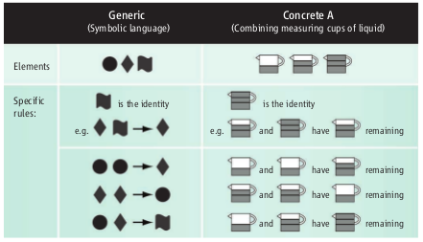
Abstract vs. Concrete Examples

Slide 8
AutoTutor
University of Memphis
Text (and speech) conversations
Open-source version: http://gnututor.com
Demo video: https://sites.google.com/a/iis.memphis.edu/gnututor/demo

Slide 9
Apperson Prep
http://www.appersonprep.com/academics/unit_movies.aspx
http://www.appersonprep.com/academics/lesson_movies.aspx
http://www.appersonprep.com/academics/practice_questions.aspx

Slide 10
OpenStax
From the developers of Connexions (http://cnx.org)
http://openstaxcollege.org/

Slide 11
MITx
I found one course: Circuits & Eletctronics
From what I could tell, it is structured just like the Stanford AI course.
http://mitx.mit.edu

Slide 12
CMU Open Learning Initiative
“Open courses backed by learning research”
http://oli.web.cmu.edu/openlearning/index.php

Slide 13
Oklahoma State Thermodynamics
https://ecourses.ou.edu/cgi-bin/ebook.cgi?topic=th

Slide 14
Gradiance
http://www.gradiance.com/pub/demo.html
Interesting treatment of multiple choice question sets
Programming “labs” – small programming exercises

