Slide 1
The Adaptive Concept Map
Jacob Moore
CS 6604
4/25/12

Slide 2
Motivation
Textbooks are widely used in engineering education practice
Textbooks are rarely studied in engineering education research (CS being an exception)
With the rise of digital textbooks, there is a potential for some very fundamental changes in how textbooks look, feel and are used.

Slide 3
Learning Theory Driven Design
Start by looking at the relevant literature on how people learn.
Come up with a list of design goals informed by the education literature.
Build software to match the goals.

Slide 4
What to Focus On?
How will the user find/navigate the information?
How will I string the information together?
What types of presentations and/or interactive elements do I need to include to get an idea across
How much “interactivity” should I have?
Do I include just narration or narration and text with multimedia?
Macro
Micro

Slide 5
The Goal
Conceptual Understanding (Meaningful Learning)
More than simple recall (procedural / declarative knowledge)
Both procedural / declarative knowledge and conceptual understanding allow for efficiency (ability to perform routine tasks quickly and accurately)
Conceptual understanding allows for improvisation and innovation (better solvers of novel problems)

Slide 6
Meaningful Learning
Problem Based Learning with a Facilitator
Scientific Research
Solving Homework Problems with a Textbook
Reading a Textbook or Listening to a Lecture
Reception Learning
Discovery Learning
Trial and Error Problem Solving (Tinkering)
Learning the Times Tables
Rote Learning
(Ausubel 1968)

Slide 7
Meaningful Learning
Problem Based Learning with a Facilitator
Scientific Research
Solving Homework Problems with a Textbook
Reading a Textbook or Listening to a Lecture
Reception Learning
Discovery Learning
Trial and Error Problem Solving (Tinkering)
Learning the Times Tables
Rote Learning

Slide 8
Advance Organizers
An overview of the information to be presented.
High level of abstraction.
Presented before detailed instruction.
In language that can be understood by novices.
Build up from the learners prior knowledge if possible.
Shown to have a small but statistically significant effect on meaningful reception learning.
(Ausubel, 1960; Ausubel & Fitzgerald, 1961, 1962; Ausubel & Youssef, 1963; Luiten, Ames, & Ackerson, 1980)

Slide 9
Concept Maps
Concept maps were originally developed in the 1970’s to diagram what children did and did not know (Novak & Cañas, 2008).
Meant to be a graphical representation of a person’s cognitive schemas
Node-Link diagrams consisting of…
Concepts (nodes)
A perceived set of regularities in the world
Propositions (two directly linked nodes)
A perceived relationship between two concepts

Slide 11
Concept Maps, as Advance Organizers
Concept Maps are effective instructional tools in one of two ways:
The student creates a concept map of their own knowledge on a subject as a reflective learning activity.
An expert-generated concept map is used as an advance organizer.

Slide 12
Concept Maps, as Advance Organizers
Concept maps can server as powerful advance organizers, particularly if there are anchor concepts (Novak, 2010).
Reasons
They match how information is stored in long term memory
People can more quickly scan the visual information for key details
Lower cognitive load than text

Slide 13
Map Shock
Concept maps do not work as advance organizers beyond a certain level of complexity.
“Map shock” is a cognitive and affective reaction to large and complex concept maps that results in the incomplete processing of those maps (Blankenship & Dansereau, 2000).

Slide 14
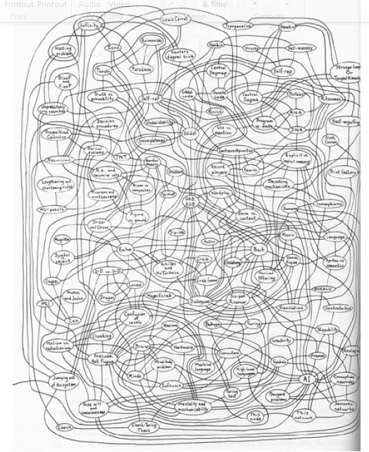
Hofstandter (1979)

Slide 15
Current Solutions to Map Shock
Animated maps
Maps are built up node by node and with accompanying narration
Imposes a linear format on the map, bad for a searching tool
Stacked Maps
Break the map down into several smaller maps
Can be disorienting
Hinders crosslinking
Ignores personal preferences

Slide 16
What Causes Map Shock?
Cognitive Overload
Too much information to process at once
Learning
Rate at Which Information is Presented

Slide 17
What Causes Map Shock?
Cognitive Overload
Too much information to process at once
Learning
Learning
Rate at Which Information is Presented
Rate at Which Information is Presented

Slide 18
Cognitive Load Theory
(Paas, Renkl, & Sweller, 2004; Sweller, 1988)
A person’s working memory has limited capacity (Miller, 1956).
7 ± 2
Three types of load (intrinsic, extraneous, and germane)
All types of loading are additive (competing for the same capacity)
Most efficient learning occurs when load matches capacity

Slide 19
Cognitive Load Theory
Intrinsic Load (1st Priority)
The load imposed by performing some task
Driving
Reading
Examining a graph

Slide 20
Cognitive Load Theory
Extraneous Load (2nd Priority)
The load imposed by performing some unnecessary task (wasted load)
Physiologically indistinguishable from intrinsic load
Having a conversation while driving
Reading a description of a picture to form a metal picture of your own
Reading raw data (rather than a graph) to form opinions

Slide 21
Cognitive Load Theory
Germane Load (3rd Priority)
The load imposed by processing information in such a way to store it in long term memory (Learning)
Physiologically different from intrinsic/extraneous loading
Only occurs if the intrinsic/extraneous load is low enough that capacity is available.

Slide 22
Back to Map Shock
Large complex maps are so difficult to interpret that there is no remaining capacity for germane loading
We want a way to preserve the positive effects of concept maps have on learning, and we want to make concept maps more scalable.
We do this by managing cognitive load
Don’t compromise navigation ability of the tool

Slide 23
Information Visualization
Investigates ways of displaying large sets of abstract data in ways that support insight
Managing cognitive load is a primary concern in the field of information visualization
Use information visualization literature along with the traditional advance organizer / concept map literature to create the design goals.

Slide 24
Adaptive Map Design Goals
Tool will serve as a navigation system and advance organizer
Usability is a primary goal (never overwhelm the user)
Automatic concept map generation (ease of content creation)

Slide 25
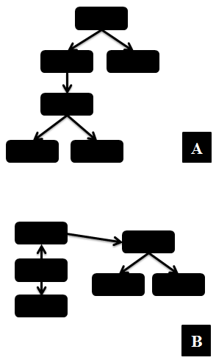
Adaptive Map Design Goals
Separate software and content as much as possible (ease of content creation)
Allow for user adjustability
Good symmetry and predictability (sense of familiarity)

Slide 26
Adaptive Map Design Goals
Minimize link length and link crossings
Good continuation (a consistent flow to the information) vertically oriented flow.
Simple use of color to indicate link or node type

Slide 27
Adaptive Map Design Goals
Help user maintain a sense of context while viewing details (either smooth zooming and panning or focus + context views)
Start with an overview (Overview first, zoom and filter, details on demand)

Slide 28
Implementation
Visualization Software
Java Applet
ZVTM (Zoomable Visualization Transformation Machine)
Graph Viz (Graph Class)
Content
XML for the Concept Map
HTML for the content pages

Slide 29
Evaluation
Pilot Testing and Debugging
Spring 2012, Summer 2012
Formal Evaluation
Fall 2012
Evaluate conceptual understanding
Evaluate student usage patterns
Evaluate student opinions

Slide 30
Evaluation
Evaluating Conceptual Understanding
Statics Concept Inventory (Steif & Dantzler, 2005)
Problem Sets and Observations

Slide 31
Questions

Slide 32
References
Ausubel, D. P. (1960). The Use of Advance Organizers in the Learning and Retention of Meaningful Verbal Material. Journal of Educational Psychology, 51(5), 267–272.
Ausubel, D. P. (1968). Educational Psychology; a Cognitive View. New York, NY: Holt, Rinehart and Winston.
Ausubel, D. P., & Fitzgerald, D. (1961). The Role of Discriminability in Meaningful Learning and Retention. Journal of Educational Psychology, 52(5), 266–274.
Ausubel, D. P., & Fitzgerald, D. (1962). Organizer, General Background, and Antecedent Learning Variables in Sequential Verbal Learning. Journal of Educational Psychology, 53(6), 243–249.
Ausubel, D. P., & Youssef, M. (1963). Role of Discriminability in Meaningful Paralleled Learning. Journal of Educational Psychology, 54(6), 331–336.
Blankenship, J., & Dansereau, D. (2000). The Effect of Animated Node-Link Displays on Information Recall. The Journal of Experimental Education, 68(4), 293–308.
Luiten, J., Ames, W., & Ackerson, G. (1980). A Meta-analysis of the Effects of Advance Organizers on Learning and Retention. American Educational Research Journal, 17(2), 211 –218.
Miller, G. A. (1956). The Magical Number Seven, Plus or Minus Two: Some Limits On Our Capacity For Processing Information. Psychological Review, 63(2), 81–97.
Novak, J. D. (2010). Learning, Creating, and Using Knowledge: Concept Maps as Facilitative Tools in Schools and Corporations. New York, NY: Taylor & Francis.
Novak, J. D., & Cañas, A. J. (2008). The Theory Underlying Concept Maps and How to Construct and Use Them (Technical Report No. Cmap Tools 2006-01 Rev 01-2008).
Paas, F., Renkl, A., & Sweller, J. (2004). Cognitive Load Theory: Instructional Implications of the Interaction Between Information Structures and Cognitive Architecture. Instructional Science, 32(1/2), 1–8.
Steif, P. S., & Dantzler, J. A. (2005). A Statics Concept Inventory: Development and Psychometric Analysis. Journal of Engineering Education, 94(4), 363–372.
Sweller, J. (1988). Cognitive Load During Problem Solving: Effects on Learning. Cognitive Science, 12(2), 257–285.

