Slide 1
Khan Academy
Eric Fouh
CS6604 Spring 2012
January 25, 2012

Slide 2
Introduction
Winner in 2008 of Google’s “Project 10 to the 100”
Awarded for their contribution in “making educational content available online for free”
Received 2 millions USD from Google

Slide 3
Cloud Infrastructure
Runs on Google App Engine (GAE)
Only Java and Python supported
YAML configuration file: match URL to request handlers
schemaless data modeling and storage: Datastore /Google Bigtable

Slide 4
Technology:HTML5
- A work in progress
Next standard for HTML, XHTML, and the HTML DOM
Already supported by most browser
Features:
The video and audio elements for media playback (<audio>, <video>, <embed>, etc tags)
The canvas element for drawing (<canvas> tag with all drawing handled by JavaScript)
New content specific elements, like article, footer, header, nav, section
New form controls, like calendar, date, time, email, url, search
User geolocation
Notes:
http://www.w3schools.com/html5/

Slide 5
Technology:HTML5
Better support for local offline storage:
Cookies are replace by two objects :
localStorage : stores user and applications data with no time limit
sessionStorage - stores user and application data for one session
interface Storage {
readonly attribute unsigned long length;
DOMString? key(unsigned long index);
getter DOMString getItem(DOMString key);
setter creator void setItem(DOMString key, DOMString value);
deleter void removeItem(DOMString key); void clear();
};

Slide 6
Technology: JavaScript
jQuery : JavaScript library to use CSS selectors to implement quick HTML document traversing, event handling, animations, and Ajax interactions. No more in-line JS code
YUICompressor: JavaScript code compressor which goal is to minimize page size therefore download time.
Highcharts JS: JavaScript charting library offering intuitive, interactive charts for web application. Used to visualize several metrics like student performance.
Raphaël: JavaScript library for vector graphics on the web. Used for the scratchpad when doing exercises.
Notes:
http://developer.yahoo.com/yui/compressor/
http://www.highcharts.com/
http://raphaeljs.com/

Slide 7
Technology: Other Tools
ASCIIsvg: JavaScript script for creating and describing pictures on webpages using standard mathematical coordinates
ASCIIMathML: JS script to produce math formulas on webpages using calculator-style and LateX style syntax
MathJax: Math visualization library for inputs of MathML and LaTeX
Google Maps API v3 is used for the exercise dashboard: the Knowledge map
Google Analytics is a tracking tool for stats on your visitors

Slide 8
Data
Playlists
Videos
Exercises
Badges
Users and User Data

Slide 9
Data: Playlists
Youtube Playlists: collection of Videos
Attributes
youtube_id | url
title | Description
Readable_id | tags

Slide 10
Data: Videos
Youtube Videos (embedded)
Attributes:
Youtube_id | url
title | description
Playlists | Keywords
Duration | readable_id
views | date_added
download_version

Slide 11
Data: Exercises
HTML5+JS+CSS file
Attributes
name | short_display_name
prerequisites | covers
v_position | h_position
second_per_fast_problem | live
summative | author
raw_html | last_modified
creation_date

Slide 12
Data: Exercises
Main Library khan-exercise.js
Fixed number of exercises (now 10) are selected for each topic. Problems selection is based on exercise “weight” are not randomly.
Weight are set up manually e.g.<div id="polynomial" data-weight="4">
Exercises are load from the server:
.
jQuery.ajax({
// Do a request to the server API
url: server + "/api/v1/user/exercises/" + exerciseName,
type: "GET",
dataType: "json",
// Make sure cookies are passed along
xhrFields: { withCredentials: true },
success: prepareUserExercise
});

Slide 13
Data: Exercises
Data Interchange Format: JSON
JavaScript Object Notation
Ligthweight (compared to XML)
Provided with JS
http://www.khanacademy.org/api/v1/exercises
{ "covers": [ "addition_2", "multiplication_0.5" ],
"creation_date": "2011-08-29T00:00:00Z",
"display_name": "Multiplication 1", "h_position": 2,
"ka_url": http://www.khanacademy.org/exercise/multiplication_1",
"kind": "Exercise", "live": true,
"name": "multiplication_1", "num_milestones": 1,
"prerequisites": [ "addition_2", "multiplication_0.5" ],
"relative_url": "/exercise/multiplication_1",
"seconds_per_fast_problem": 4.0, "short_display_name": "Mult. 1", "summative": false,
"v_position": 2
},

Slide 14
Data: Exercises
Server communication: - Very few communication with the server - It loads the exercises from the server, - runtime data stored locally: Uses HTML5 "LocalStorage" capability to store user information locally uid,screen name, etc
Enabling localStorage: localStorage[ uid ] = uid;(where uid is current date and time)
Store data locally:

Slide 15
Data: Exercises
Structure:
Principal classes:
Vars: variables of the problem
Question:
Solution: Multiple or not
Hints
Optional classes
Summary: description of the problem
Graphie: for exercises with animations/graphs/etc.

Slide 16
Data: Exercises
User answer assessed locally
Send summary of user's action to the server (upon completion of the exercise)
Information sent to the server:
If the user answer was correct
If the user used a hint
How long he took to complete the problem
How many times the problem was attempted
User’s answer
The seed that was used to select the exercises

Slide 17
Data: Badges
Granted…
Upon completion of a required number of exercises
Spending enough time watching videos
Upon completion
Attributes
Badge_name | Count_awarded
Date_last_calculated
Custom badges
Description | Points
Category | Icon
User badges
User | Date
Badge name | Context
Points earned

Slide 18
Data: Badges
{
"badge_category": 1,
"description": "Going Transonic",
"name": "greattimedproblembadge", "points": 500,
"safe_extended_description": "Quickly & correctly answer 10 exercise problems in a row (time limit depends on exercise difficulty)",
"user_badges": [ {
"badge_name": "greattimedproblembadge",
"date": "2011-05-04T06:02:05Z",
"kind": "UserBadge", "points_earned": 500,
"target_context": { ... /* The target_context will contain either an Exercise or Playlist entity */ ... },
"target_context_name": "Addition 1",
"user": "you@gmail.com" },
] },

Slide 19
Data: Users and User Data
Student List:
User Video:
Information linking a user to the videos he uploaded
User Playlist
Data about the interaction of a user and a playlist: name of the playlist, last watched time, seconds, etc.
Attributes
Name | coaches
Notes:
user = db.UserProperty()
video_css = db.TextProperty()
pickled_dict = db.BlobProperty()
last_modified = db.DateTimeProperty(required=True, auto_now=True, indexed=False)
version = db.IntegerProperty(default=0, indexed=False)

Slide 20
Data: Users and User Data
Video Logs
Data about the user and the videos he watched: user name, video title, time watched, points earned, playlist title
Problem Logs
Attributes
user | Exercise
correct | time_taken
hint_time_taken_list | hint_after_attempt_list
count_hints | hint_used
points_earned | earned_proficiency
suggested | ip_address, etc.

Slide 21
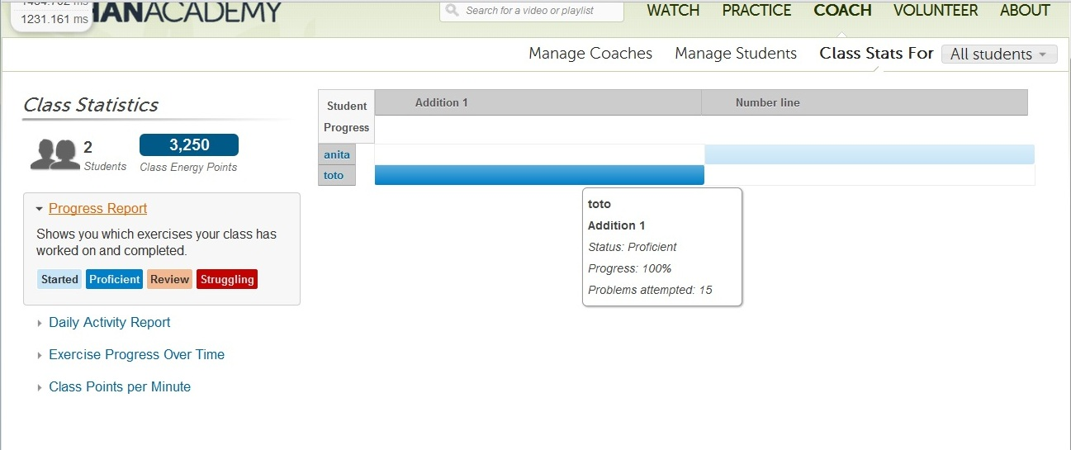
Data: Users and User Data

Slide 22
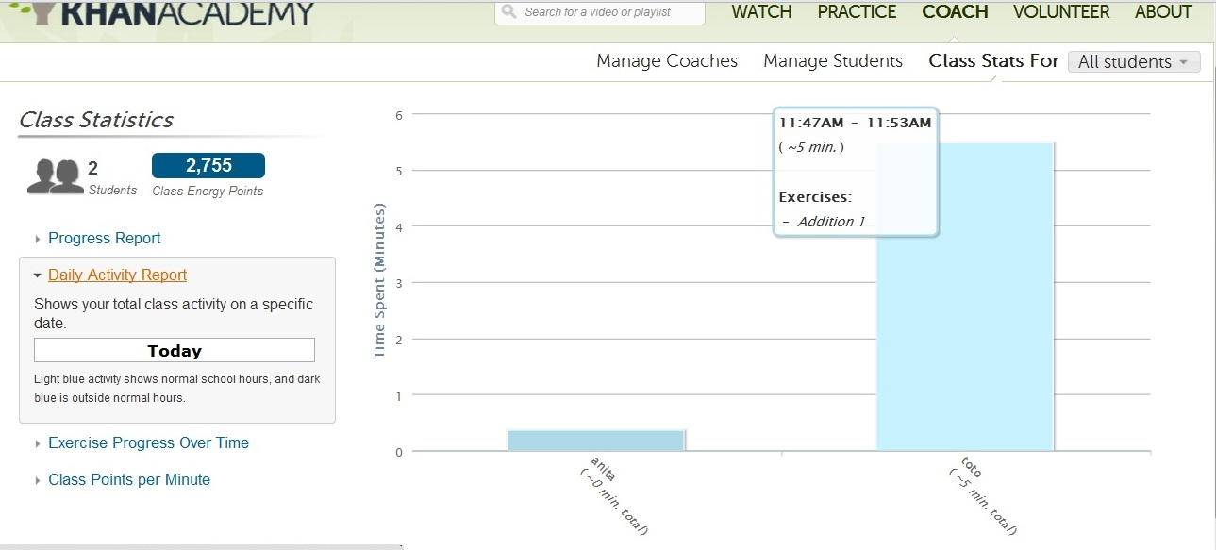
Data: Users and User Data

Slide 23
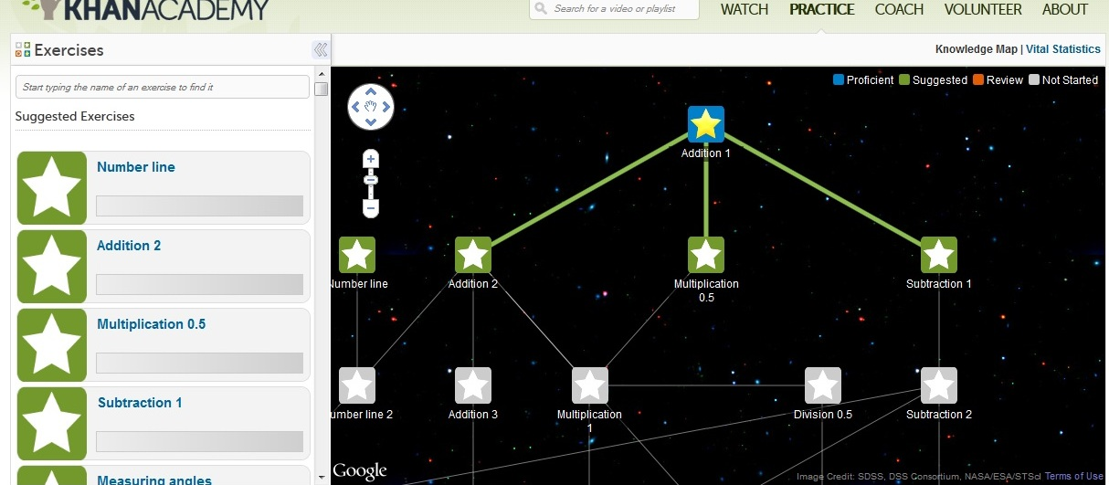
Data: Users and User Data

Slide 24
Conclusion
Khan Academy is not an eTextBook but has some features (assessment system, Tracking tools) that should be present in an eTextBook
Khan Academy is a good example of learning system that: “leverage technology to create relevant learning experiences that mirror students’ daily lives and the reality of their futures.” --2010 U.S. Department of Education’s report, Transforming American Education, Learning Powered by Technology.

