Slide 1
CUELC Cairo University E-Learning Center
Sally Hamouda
CS6604 Spring 2012
February 13

Slide 2
Introduction
CUELC is a TEMPUS project lasted from 2005 to 2009.
TEMPUS is a program established by the EU to:
Support the relation between European Universities and neighboring countries universities.
Improve higher education at universities in Europe and in other partner countries .

Slide 3
Introduction
CUELC Objectives
Enhancing teaching staff skills
Allowing web-based student-student and student-teacher interaction
Offering learning on demand and life-long learning possibilities
Eleven courses of the computer engineering
CULEC Partners
Cairo University, Faculty of Engineering, Egypt
RWTH Aachen University, Aachen, Germany
Institut National des Télécommunications, Evry, France

Slide 4
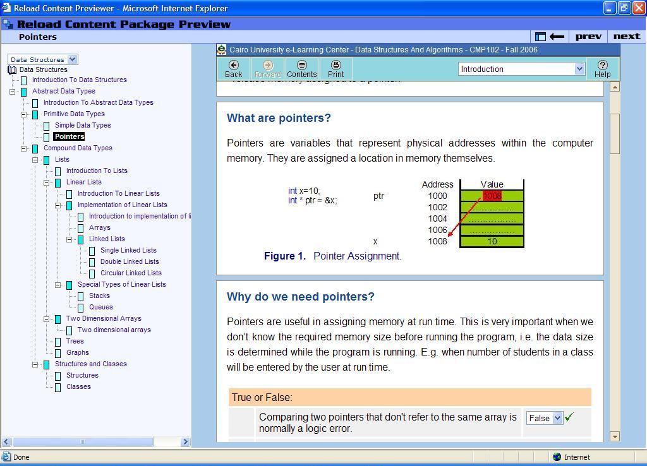
A Tour in CULEC
http://elearning.eng.cu.edu.eg/

Slide 5
Steps to create a Course
Senior instructors:
Compile multiple text books and lectures
Divide into lessons maps to lectures
Use Instructional design technology to present lessons
Put the material in template form (if possible) (.doc file)
Suggest self assessments and quizzes questions
Suggest concepts to create visualization
Notes:
Instructional design (ID) is a technology that provides a set of rules and guidelines for presenting educational content in the most efficient manner, for all types of subjects and audiences.

Slide 6
Steps to create a Course
Engineers:
Convert the .doc lessons to html files then to SCORM packages
Using RELOAD
Search for ready made visualizations/resources
Create visualizations
Using Flash , Java and Power point
Create question banks , quizzes and self assessments
Using Moodle questions and Java Script
Search for possible additional questions
Create brochures , posters ,tutorials and hold workshops for faculty members.

Slide 7
What is SCORM ?
Sharable Content Object Reference Model
It is the de facto industry standard for e-learning LMS.
Governs how online learning content and Learning Management Systems (LMSs) communicate with each other.
Does not speak to instructional design or any other pedagogical concern, it is purely a technical standard.

Slide 8
What is RELOAD?
Reusable Learning Object Authoring and Delivery
A tool for viewing, editing and creating IMS and SCORM Content Packages
Allow both open source and commercial developers
Integrated Metadata Editor
Allow easy creation of SCORM content

Slide 9
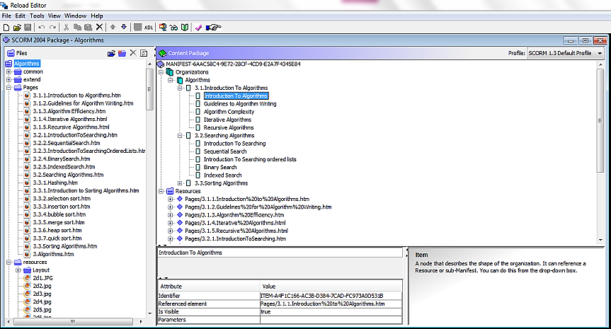
How to Create a SCORM Package?
1- Open reload editor
2- Create SCORM package
7- Package it
6- Preview your Package
4- Select Content to Import
3- Add Organization
5- Drag individual files for inclusion in the package

Slide 10
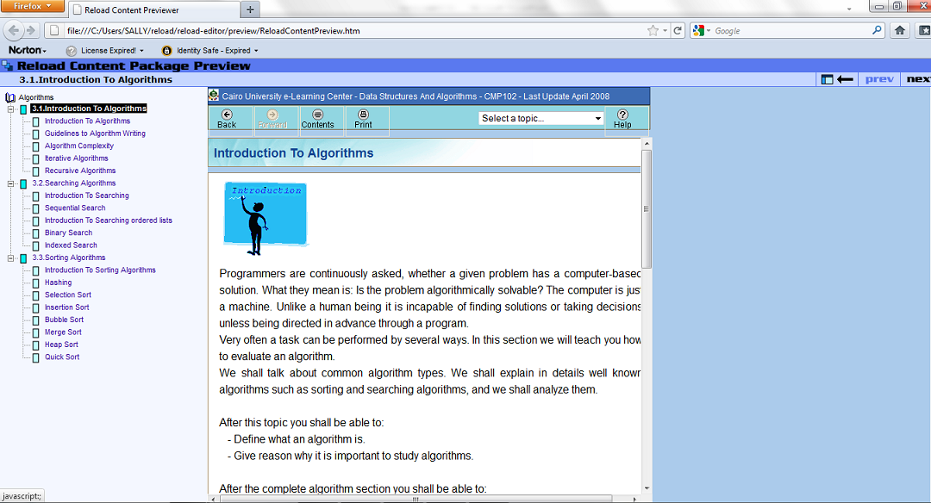
How to Create a SCORM Package?
Notes:
http://www.reload.ac.uk/ex/editor_v1_3_manual.pdf
http://www.reload.ac.uk/ex/ReloadSSv1.pdf

Slide 11
What is Moodle?
Moodle is an Open Source Course Management System LMS
Very popular among educators around the world as a tool for creating online dynamic web sites for their students
Has activity modules (such as forums, databases and wikis)
A way to deliver content to students (e.g. SCORM packages) and assess learning using assignments or quizzes

Slide 12
Moodle Quizzes & Question bank

Slide 13
Moodle Quizzes & Question bank

Slide 14
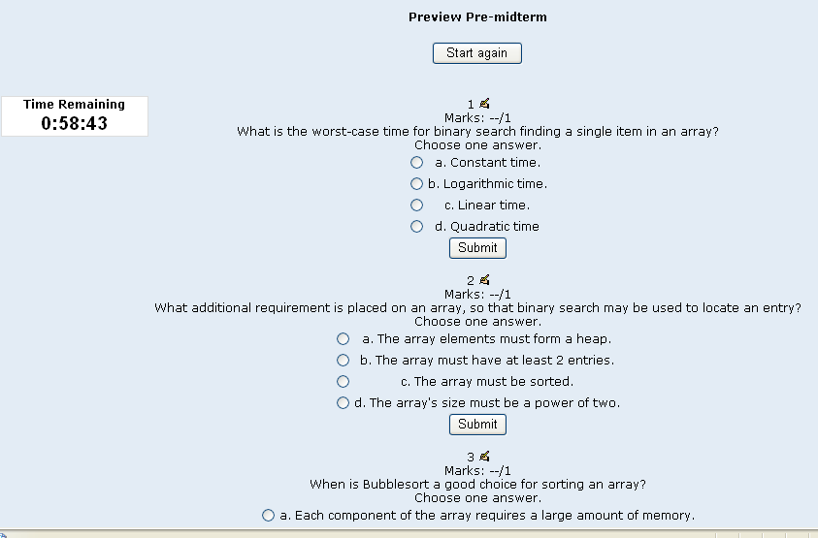
Moodle Quizzes & Question bank

Slide 15
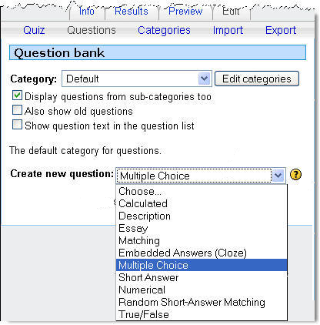
Moodle Quizzes & Questions bank

Slide 16
Features added to Moodle
GISMO: Graphical Interactive Student MOnitoring tool
Online session:
CUELCAL: A Live Session with Advanced Features for the MOODLE , 5th AUC International Conference on e-Learning Applications
Myamic Editor
Plagiarism detection
Notes:
http://193.147.71.88:9673/webs/edukalibre/documentation/gismo.pdf

Slide 17
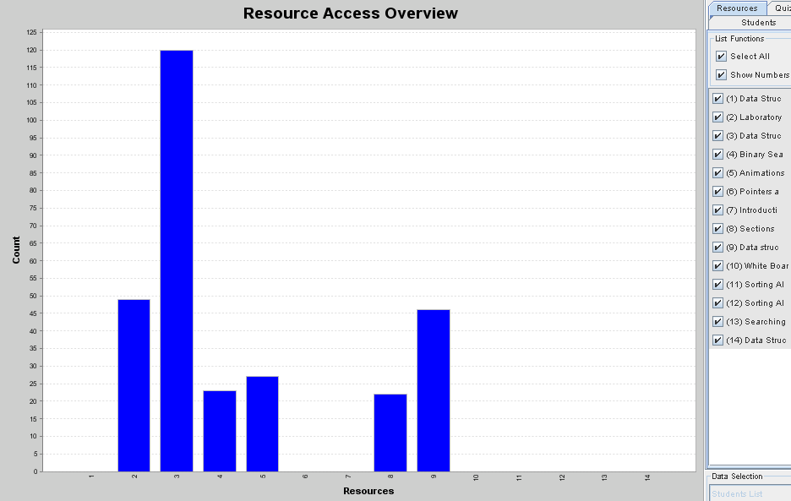
GISMO Graphical Interactive Student MOnitoring tool
Notes:
GISMO is a student monitoring and tracking system that uses the students' tracking
data from a Moodle, transforms the data into a form convenient for processing, and
generates graphical representations that can be explored and manipulated by course
instructors to examine social, cognitive, and behavioural aspects of distance students.

Slide 18
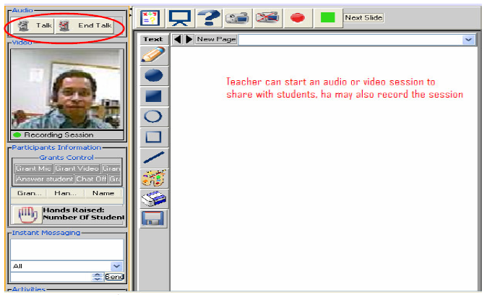
CUELCAL

Slide 19
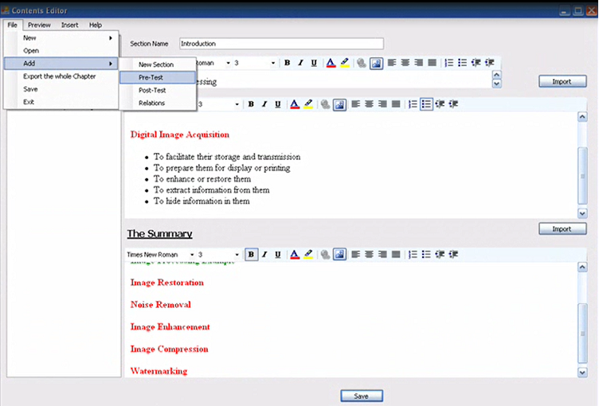
Myamic Editor

Slide 20
Features added to Moodle
GISMO: Graphical Interactive Student MOnitoring tool
Online session:
CUELCAL: A Live Session with Advanced Features for the MOODLE , 5th AUC International Conference on e-Learning Applications
Myamic Editor
Plagiarism detection
Notes:
http://193.147.71.88:9673/webs/edukalibre/documentation/gismo.pdf

Slide 21
Evaluation

Slide 22
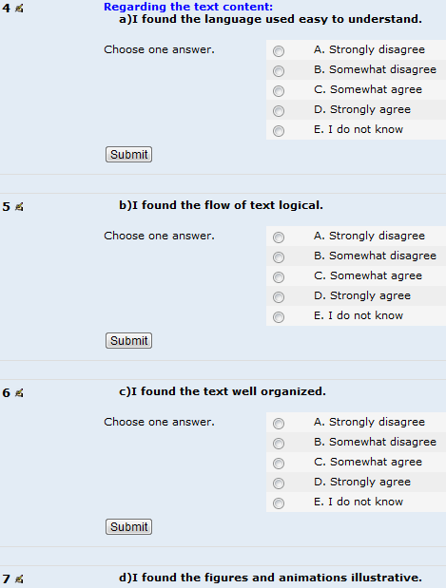
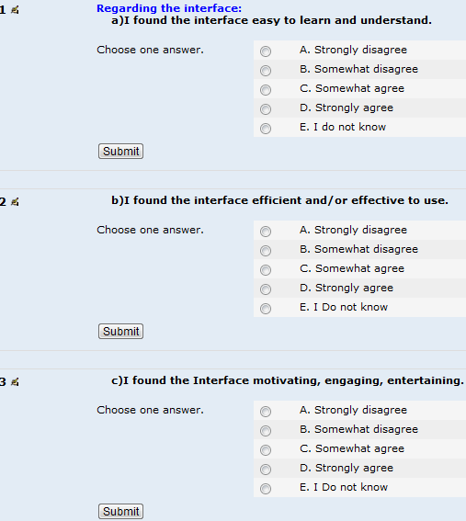
Feedback Form

Slide 23
Overall Satisfaction Analysis
Notes:
Std: Strongly disagree student % , smd: somewhat disagree: ... So on

Slide 24
Detailed Satisfaction Analysis
Interface

Slide 25
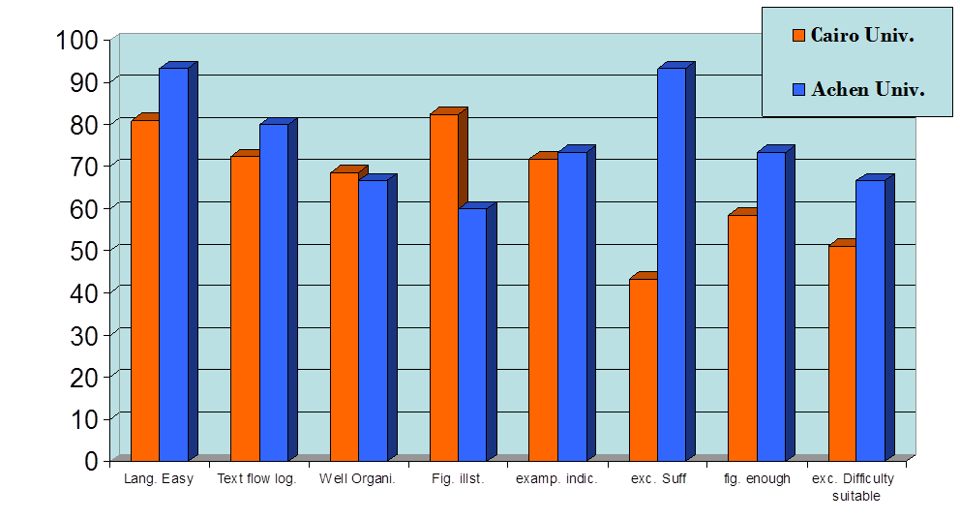
Detailed Satisfaction Analysis
Content

Slide 26
Students’ Comments
Lessons not clear:
Trees
Hashing
Online session:
Waste of time
Very slow
Need more Animations and exercises

Slide 27
Technology and SWs used
Java Script
PHP
HTML
Flash
Java
RELOAD
CAM Studio
Camtasia
TextAloud
Icon Creator
Photoshop

Slide 28
Conclusion
CUELC aims at:
Allowing web-based student-student and student-teacher interaction
Offering learning on demand and life-long learning possibilities
Students are now involved in creating visualization for different courses.
CUELC is still used for
Sharing resources
Assignments submission
Help teacher in class
As a reference to students to study at home

Slide 29
Thanks

