Slide 1
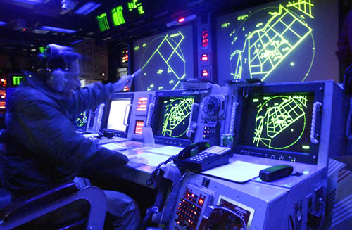
Intelligent Tutor
Dave_Congwu Tao
March 26, 2012

Slide 2
The Outline
1. What is an intelligent tutor & intelligent tutoring system?
2.The related research on Intelligent tutoring system
3.Discuss it for Etextbooks

Slide 3
What is an intelligent tutor?
Intelligent tutor = Artificial intelligent + computer-based Tutor ?
Up to a point, Siri of Apple is an intelligent tutor.

Slide 4
The definition of Intelligent tutoring system (ITS)
In 1982, Sleeman and Brown reviewed the state of the art in computer aided instruction and first coined the term “Intelligent Tutoring Systems (ITS)”.

Slide 5
The definition of Intelligent tutoring system (ITS)
An intelligent tutoring system (ITS) is any computer system that provides direct customized instruction or feedback to students, i.e. without the intervention of human beings, whilst performing a task.
--wikipedia.org

Slide 6
The History of ITS
CAI
ICAI
ITS

Slide 7
The Traits of ITS
A step beyond ICAI, since in 1970
leading to new classes of problems and approaches.
Includes artificial intelligence concepts:
  Knowledge representation and communication
  problem-solving approaches
  dynamic student modeling
  human cognition
  intelligent user interfaces
  intelligent help systems
  use of strategies

Slide 8
The Relationship AI of Instruction
Constructivisim
Cognitive Theory
Artificial Intelligence
Explore
Practice
ICAI, ITS
CAI
Agent

Slide 9
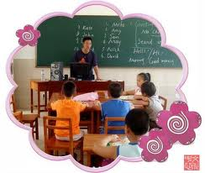

ITS and Cognitive Theory
How to teach
How to guide/coach

Slide 10

What will an ideally intelligent tutor do ?
Could point out the students’ mistakes during their learning process,and give a prompt feedback and help them to correct
Deliver the proper content to the students according to their interests,levels,etc with appropriate rhythem
Why make mistake
How to help to correct

Slide 11
What will an ideally intelligent tutor do ?
How is the knowledge learned,stored and retrieved?
What is the teaching ability?
Why the students make mistakes?
Analyzing

Slide 12
Intelligent Tutoring System(ITS)
Computer
Science
Cognitive
Theory
ITS
Knowledge

Slide 13
Architecture of an ITS
Tutor Module
Instructional
Expert Module
Intelligent
Interface
Student Module
user

Slide 14
Components of an ITS
Expert Module: contains the expert's knowledge
on the domain (subject knowledge).
Interface Module: reponsible for the communication
between the computer system and
the student
Student Module: contains the students' knowledge,
whether correct or incorrect, about
the subject domain.
Tutor Module: contains the tutorial knowledge
(knowledge about how to teach).
Source:http://en.wikipedia.org/wiki/Intelligent_tutoring_system

Slide 15
Components of an ITS
Expert Module: contains the expert's knowledge
on the domain (subject knowledge).
Factual and procedural, is maintained in
databases
2) Provides a closer simulation of the human
expert's reasoning process
3) The Expert Module may employ cognitive
modeling by using structured knowledge and
human-like inference mechanisms
Source:http://en.wikipedia.org/wiki/Intelligent_tutoring_system

Slide 16
Components of an ITS
Interface Module: reponsible for the communication
between the computer system
and the student
1) Management of student-computer interactions
  --Facilities for teaching
  --Problems, or exercises
  --Investigating, exploring and stimulating
2) Interface design
  --Interaction device (hardware)
  --Interaction design (menus, icons, …)
Source:http://en.wikipedia.org/wiki/Intelligent_tutoring_system

Slide 17
Components of an ITS
Student Module: contains the students' knowledge,
whether correct or incorrect, about
the subject domain
P: procedural knowledge,
2) C: conceptual knowledge,
3) T: individual traits, typically a set of labels,
e.g. introvert, blind, bored, etc.,
4) H: history, a transcript of the interactive session, summarized and interpreted to describe
significant events.
Source:http://en.wikipedia.org/wiki/Intelligent_tutoring_system

Slide 18
Components of an ITS
Tutor Module: contains the tutorial knowledge ,
(knowledge about how to teach).
1)How to present the materials to be taught
2)How to discover the students' errors and how to correct them.
3)Based on the tutor’s knowledge: the didactic(how
to teach) ,the diagnostic(how to find errors),the
prescriptive(how to correct errors )
Source:http://en.wikipedia.org/wiki/Intelligent_tutoring_system

Slide 19
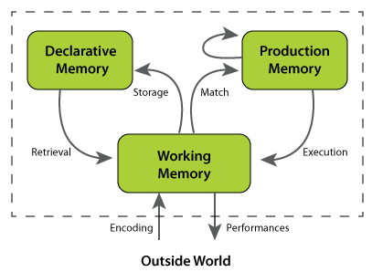
The Practice of ITS
Case 1: Geometry Tutor (Jonh.Andson ,1985 ,CMU )
Case 2: LISP Tutor (Jonh.Andson ,1985 ,CMU)
1) Based on ACT* theory of cognition (Jonh.Andson,1976)
2) The ACT* theory focuses on memory processes. Three types of memory structures: declarative, procedural and working memory.
Goal structure of the problem space
2. In the context of problem-solving.
3. Immediate feedback on errors.
4. Minimize working memory load.
5. Adjust the "grain size" of instruction
6. Enable the student to approach the target
skill by successive approximation.

Slide 20
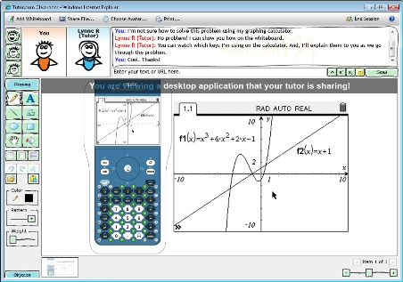
The Practice of ITS
Case 1: Geometry Tutor (Jonh.Andson ,1985 ,CMU )
1) Based on ACT* theory—the use of an ideal model, a proof graph
to represent problem structure, instruction in context and
immediate feedback
2)The experiment showed three students learned geometry
successfully and were solving problems more complex and claimed
to like geometry

Slide 21
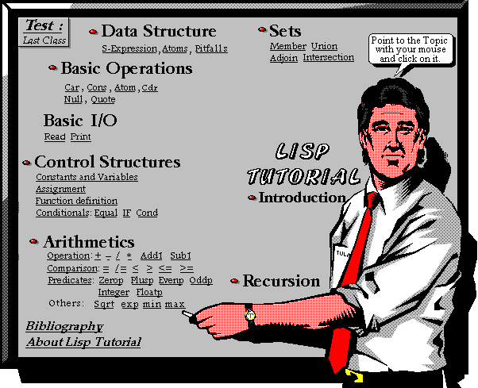
The Practice of ITS
Case 2: LISP Tutor (Jonh.Andson ,1985 ,CMU)
1) Based on studies of how students learn programming,
according to the ideal model for LISP programming, an interface for
communicating in context and immediate feedback.
2)The experiment showed students working with the computer tutor spent
30% less time doing the problems associated with the lessons and scored
43% better on the final exam than the students on their own.

Slide 22
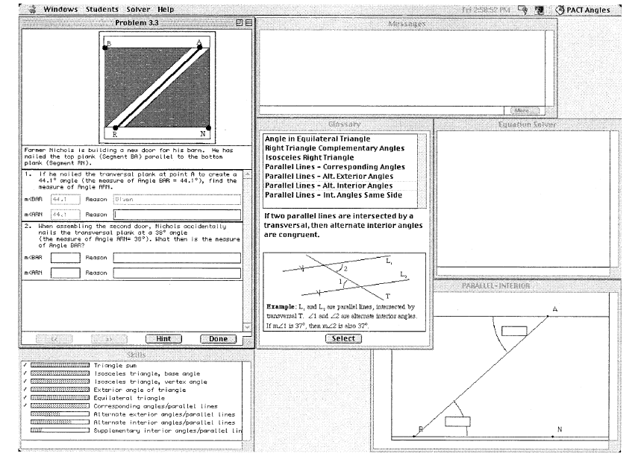
The Practice of ITS
Case 3: Computer-based Cognitive Tutor (Jonh.Andson ,2002 ,CMU)
1) Based on ACT* theory—provide support for guided learning by doing.
Assign problems on an individual basis, monitor students’ solution
steps, provide context-sensitive feedback and hints, and implement
a mastery learning criterion
2) The experiment shows by engaging in explanation,
students acquired better-integrated visual and verbal declarative
knowledge and acquired less shallow procedural knowledge.
Geometry Cognitive Tutor

Slide 23
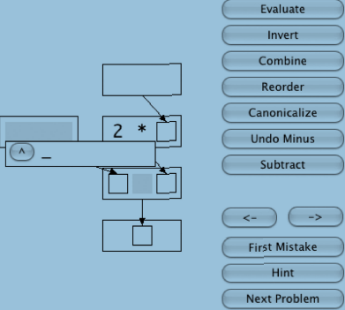
The Practice of ITS
Case 4: Computer-based Tutor (Jonh.Andson ,2009 ,CMU)
Based on ACT* theory—provides some initial guiding instruction, with further instruction if the student requests help or makes errors
2) The experiment shows with a computer-based tutor that presented algebra-like problems in a graphical representation , students can learn successfully via practicing under minimal guidance
The Interface of the Computer-based Tutor

Slide 24
The Practice of ITS
Other Cases :
MYCIN -- was written in Lisp in the early 1970s at Stanford University, focusing on
identifying bacteria causing severe infections, and to recommend antibiotics,
with the dosage adjusted for patient's body weight.
WEST-- a coach system. It is built on top of the game "How the West was Won". It is a
child's game, a variation of a game also called "Shoots and Ladders”.
The game was originally available on the PLATO system. PLATO is the
tutoring environment that was developed by Computer Development
Corporation, CDC, in the 1960s.
GUIDON--was desidged by Clancey in 1987, an intelligent computer-aided
instructional program for teaching diagnosis. knowledge is represented as
linguistic schemas (rules) , like: If….Then…

Slide 25
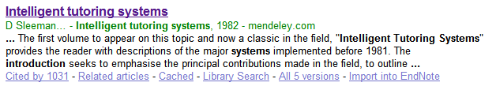
The Practice of ITS
Other Cases :
From 1985s, most of researches on ITS just cite the following article--- the times cited is 1031
We can get more information from the website:
http://www.carnegielearning.com (Dr. Jonh.Andson, CMU)

Slide 26
The Current Research Problems of ITS
ITS– focus on teacher-centered approach, what about student-
centered approach? Can ITS help to improve collaborative learning
among students ?
2) The current learning theory can not explain thoroughly the reason
why the students make mistakes and how to help them to correct.
3) It is not easy to verify the ITS is effective
4) ITS–-Most research focus on these fields like mathematics,
programming language skills for students, what about other fields
like ideological areas, probably the Siri of Apple is a good beginning.

Slide 27
What can we use ITS for Etextbooks ?
Currently, we can focus on applying it into the fields:
mathematics, programming language skills for students.
2) Integrate the Intelligent interface module and tutor module into
the etextbooks
3) Strength the research on the man-machine-dialogue technology

Slide 28
Reference
Anderson, J. R., C. F. Boyle, et al. (1985). "Intelligent tutoring systems" Science 228(4698): 456-462.
2. Aleven, V. A. and K. R. Koedinger (2002). "An effective metacognitive strategy: Learning by doing and explaining with a computer-based Cognitive Tutor." Cognitive Science 26(2): 147-179.
3.Brunstein, A., S. Betts, et al. (2009). "Practice enables successful learning under minimal guidance." Journal of educational psychology 101(4): 790.
4. Anderson, J. R., F. G. Conrad, et al. (1989). "Skill acquisition and the LISP tutor." Cognitive Science 13(4): 467-505.
5. http://www.carnegielearning.com
6. http://en.wikipedia.org/wiki/Intelligent_tutoring_system

Slide 29

Questions?

