Slide 1
Internationalization of eTextbook material
Suruchi Deodhar
CS6604: Reinventing the eTextbook
April 9, 2012

Slide 2
Agenda
Cultural Dimensions and Global Web Design
Localized Iterative Design for Language Learning
Culturability: The Merging of Culture and Usability

Slide 3
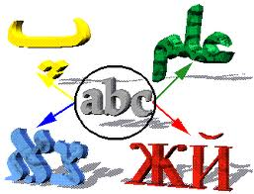
Cultural Dimensions and Global Web Design
Impact of culture on use and understanding of web-based communication and content
Differences in languages and
interpretations
Not just translation – Navigation,
interactions or appearance should
not confuse, alienate or offend users
Writing conventions like date and time formats based on region
Local laws and regulations

Slide 4
Culturability: The Merging of Culture and Usability
Usability: Learnability, efficiency and satisfaction
Due to global nature of the audience of most websites, culture impacts usability
Cultural preferences and biases impact colors, text vs. grpahics, spatial orientation and so on

Slide 5
Color-Culture chart
Color | China | Japan | Egypt | France | United States
Red | Happiness | AngerDanger | Death | Aristocracy | DangerStop
Blue | HeavensClouds | Villainy | VirtueFaith Truth | FreedomPeace | Masculine
Green | MingDynasty Heavens | FutureYouth Energy | FertilityStrength | Criminality | SafetyGo
Yellow | BirthWealth Power | GraceNobility | HappinessProsperity | Temporary | CowardiceTemporary
White | DeathPurity | Death | Joy | Neutrality | Purity

Slide 6
Global Travel ⬄Website Navigation
⬄

Slide 7
Technical Challenges
User-interface design – Not just appearance but based on cultural values
Sacred colors in the Judeo-Christian West (e.g., red, blue, white, gold) are different from Buddhist saffron yellow or Islamic green
Avoiding stereotyping of cultures
Localized search results
Relevance of search results based on local needs and changes
Back-end application design and content should be more or less the same

Slide 8
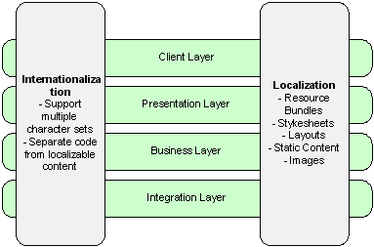
High level Architecture of a typical Global Web Application

Slide 9
Hofstede's Dimensions of Culture
Dutch cultural anthropologist, Geert Hofstede interviewed hundreds of IBM employees in 53 countries during 1978-83
Used statistical analysis techniques to find similarities and differences in cultures
Identified five dimensions of culture – highlighting patterns of thinking, feeling, and acting
Power-distance
Collectivism vs. individualism
Femininity vs. masculinity
Uncertainty avoidance
Long- vs. short-term orientation

Slide 10
Power Distance
Extent to which less powerful member accept the dominance and power exerted by the more powerful members
Affects levels of hierarchies in organizations and status
PD affects global website designs and user interfaces in following ways:
Access to information – open vs. closed
Focus on expertise, authority, official stamps, logos
Prominence given to leaders, managers as opposed to citizens
Importance of security, restrictions etc.

Slide 11
Individualism vs. Collectivism
Individualism – loose ties, every person is
responsible to look after self and immediate family
Collectivism- Strong cohesive groups that protect individuals. Unquestioning loyalty is expected.
Global website designs and user interfaces are affected as follows:
Motivation based on personal achievement maximized (individualism) or downplayed (collectivism)
Images of success portrayed or downplayed
Emphasis on change or old, traditional values
Emphasis on personal unique qualities vs. emphasizing oneness with the group

Slide 12
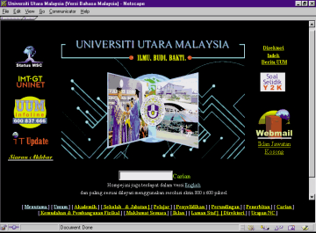
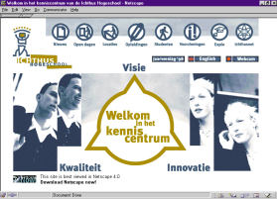
Power Distance and Individualism Index
University Website in Malaysia
PD Rating = 104
High Collectivism
University Website in Netherlands
PD Rating = 38
High Individualism

Slide 13
Masculinity vs. Femininity
Cultures that affirm gender roles vs. those that tend to collapse distinctions
Masculine: assertiveness, competition, and toughness
Feminine: orientation to home, family, tenderness
High-masculinity cultures focus on the following user-interface and design elements:
Traditional family/gender distinctions
Exploratory and controlled navigation
Games, graphics, animation, sound emphasized
Feminine cultures focus on following
Gender roles blurred
Mutual cooperation, exchange and support
Poetry, visual aesthetics, unifying values

Slide 14
Uncertainty Avoidance (UA)
Cultures vary in the extent to which they want to avoid uncertainty
Norms regarding punctuality, formality, tolerance for ambiguity
High UA cultures have more formal rules, more expressive, active, emotional people, fixed organizational structure to avoid any ambiguities, businesses focusing on tactical operations rather than strategy. Websites of high UA cultures emphasize
Simplicity
Intuitive navigation to avoid users
getting lost
Redundant cues like color, sound, typography

Slide 15
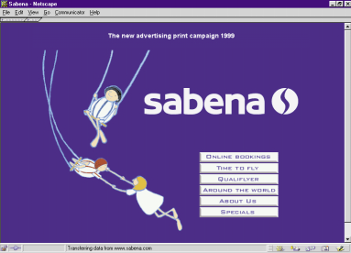
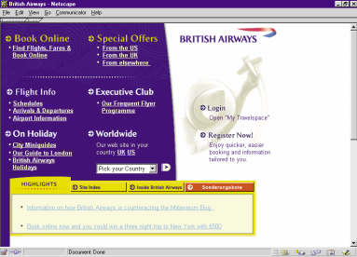
UA Comparison
High UA website from Belgium
Low UA website from UK

Slide 16
Long- vs. Short-Term Time Orientation
High LT countries emphasize the following aspects of user-interface design:
Content focused on practical value
Credibility of relationships for information
Patience for achieving goals
Low LT countries emphasize
Content focused on truth and facts
Credibility of rules rather than relationship
Immediate results

Slide 17
Culture and Website Design elements Case Study

Slide 18
Culture and Website Design elements Case Study
Analysis of data collected through the 8th GVU (Graphics, Visualization, and Usability Center) and WWW User Survey
Are there design elements which are culturally unique and specific?
Are there design elements which are genre specific?
Are there design dominance relationships between culture and genre?

Slide 19
Methodology
Culturability Inspection Method
Foraging - categorizing hundreds of Web sites by country, genre, and language
Cultural marker Identification – design elements prevalent in certain cultures
Pattern identification - emergent patterns within countries and genres are checked in cultural markers
Cultural markers help in pattern identification by country, language and genre
“User friendly” is different in different cultures. Hence culturability should be the focus of website design

Slide 20
Localized Iterative Design for Language Learning in Underdeveloped Regions: The PACE Framework Case Study

Slide 21
Need for Localization of content
Language competency is the biggest barrier to technology empowerment in developing countries
Learning English as a “foreign” language using international experiences as examples is ineffective
Learners skeptical of formal education and of cultural biases
Localization needed to make learners understand relevancy and for easy adoption

Slide 22
Challenges
Designing software applications that meet the local language learning needs without incurring content re-development costs
Users understanding might differ from educational baseline defined by software
Limited technical and computing capabilities of users can hamper learning
Learning needs continuous feedback and iterations to match the cultural sensibilities of users to enhance learning

Slide 23
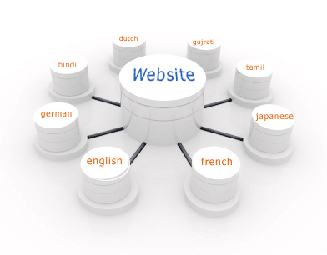
PACE framework
PACE - Pattern-Activity-Curriculum-Exercise framework
Based on modularity of educational software into pedagogy, curriculum and user interface
Educational games based teaching of English to lower income non-native English speakers in India
Built based on results of earlier studies that were not successful where
Non-familiar computer games were used
Students had difficulty using computers
User-interface design was poor

Slide 24
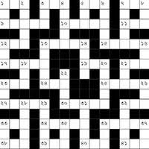
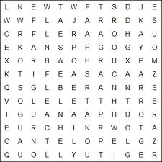
Adoption of new Teaching Framework
Best practices from computer games industry were used. Games included crossword puzzles, word searches, hangman, fill-in-the-blank, multiple choice games, matching games and word scrambles
Practices from commercial language learning packages by distilling them into design patterns
Balance of pedagogy vs. fun and engagement

Slide 25
PACE framework
Pattern - Design pattern is a “template” description of a solution to a problem that has been previously encountered and solved.
Activity – Learning activities that implement a pattern
Curriculum and Exercise – Curriculum that supports learning of a particular activity. Exercise associates an activity with curriculum

Slide 26
Conclusions from 2 User Studies of PACE Framework
Focus not just on user interface but also on educational content to suit localization
Design pattern used as an abstract representation of both user interface and curriculum
Focus on learning using an engaging ways such as games
Reusability encouraged rather than building for a target audience
Iterative design essential for rapid prototyping and deployment
Can be applied for learning in different age groups, learning levels and material, different teaching philosophies, and local cultural conventions.

Slide 27
Design of International eTextbooks
Cultural influences:
Level of interactions- formal or open
Types of motivating factors: monetary fame, honor
How should ambiguity/uncertainty be dealt with for different regions
Role of community values
Level of learning differences in individualist vs. collectivist cultures
Interaction types between teachers and students in different cultures as friends or as gurus based on power distance
Emphasis on facts/truths as opposed to virtues based on western or eastern cultures

Slide 28
Design of International eTextbooks
Design influences:
Use of design patterns
Learning along with engagement and interaction
Use of technology based on user sophistication
Modular development for quick prototyping separating the content/curriculum from user-interface and pedagogy

Slide 29
References
“Crosscurrents : Cultural Dimensions and Global Web User-Interface” by Aaron Marcus And Emilie West Gould
“Culturability: The Merging of Culture and Usability” by Wendy Barber and Albert Badre
“Localized Iterative Design for Language Learning in Underdeveloped Regions: The PACE Framework” by Matthew Kam, Divya Ramachandran, Varun Devanathan, Anuj Tewari and John Canny

Slide 30
Thank You!
Questions?

