Slide 1
Learning Styles
Theories and Validations
By: Doaa Altarawy
CS6604: Reinventing eTextBooks
Spring 2012

Slide 2
Topics
Definitions of Learning Styles
Learning Styles vs. Cognitive Styles
Cognitive Theory of Multimedia Learning
Learning Styles Models
Example 1: Felder-Silverman Model
Example 2: Rundle and Dunn Model
Validity:
Felder’s model validity
Two Criticisms
Testing the Cognitive theory of multimedia learning

Slide 3
Definitions of Learning Styles
Various approaches or ways of learning.
The various ways individuals prefer to learn.
Behaviours that serve as relatively stable indicators of how learners perceive, interact with, and respond to the learning environment.
The manners in which a learner perceives, interacts with, and responds to the learning environment

Slide 4
Learning Styles vs. Cognitive Styles
Learning Styles:
The various ways individuals prefer to learn.
Cognitive Styles (thinking Styles):
The ways individuals think, perceive
and remember information.

Slide 5
Cognitive Theory: How people learn?
Cognitive theory offers three assumptions about how people learn from words and pictures:
Dual Channel Assumption.
Human cognitive system consists of two channels for representing and manipulating knowledge: a visual-pictorial, and an auditory-verbal channels.
Limited Capacity Assumption.
Each channel has a limited capacity (at one time) for holding and manipulating knowledge.
Active Processing Assumption.
Meaningful learning occurs when learners engage in active processing within the channels.
Are more likely to occur when verbal and pictorial representations are in working memory at the same time.
Notes:
Cognitive theory offers three theory-based assumptions about how people learn from words and pictures:
Dual Channel Assumption.
human cognitive system consists of two distinct channels for representing and manipulating knowledge: a visual-pictorial channel and an auditory-verbal channel.
Pictures enter the cognitive system through the eyes and may be processed as pictorial representations in the visual-
pictorial channel.
Spoken words enter the cognitive system through the ears and may be processed as verbal representations in the auditory-verbal channel
Limited Capacity Assumption.
Each channel has a limited capacity for holding and manipulating knowledge.
When a lot of pictures (or other visual materials) are presented at one time, the visual-pictorial channel can become overloaded.
When a lot of spoken words (and other sounds) are presented at one time, the auditory-verbal channel can become overloaded.
Active Processing Assumption.
1- learning actually occurs when learners engage in active processing in those channels, including selecting relevant words and pictures, organizing them into coherent pictorial and verbal models, and integrating them with each other and appropriate prior knowledge.
2- These active learning are more likely to occur when corresponding verbal and pictorial representations are in working memory at the same time.

Slide 6
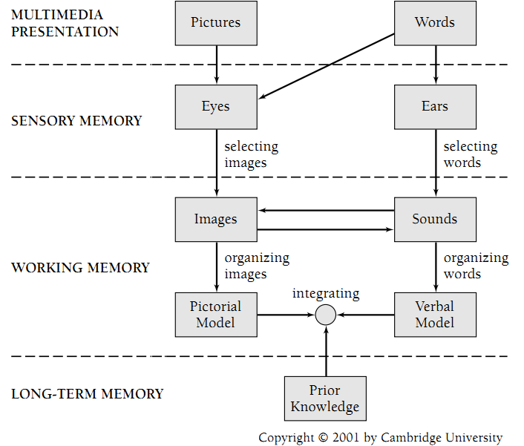
Cognitive Theory of Multimedia Learning
Notes:
The right column of the ﬁgure represents the auditory-verbal channel and the left column the
visual-pictorial channel.
Words enter the cognitive system through the ears (if the words are spoken), or through the eyes if written, and pictures enter though the eyes.
the learner pays attention to some of the words, yielding the construction of some word sounds in working memory. Also, the learner pays attention to some aspects of the pictures, yielding some images in working memory.
In the cognitive process of organizing words, the learner mentally arranges the selected words into a mental representation in working memory that we call a verbal model. Similarly, the learner mentally arranges the selected images into a mental representation that we call a pictorial model.
In the cognitive process of integrating, the learner mentally connects the verbal and pictorial models, as well as appropriate prior knowledge from long-term memory.
In education, verbal modes of instruction have traditionally played a larger role than pictorial modes of instruction.
1- Verbal modes of instruction
are based on words and include spoken text (such as lectures and discussions)
and printed text (like text in textbooks or on-screen text).
2- Pictorial modes of instruction are based on pictures and include static
graphics (such as photographs, illustrations, ﬁgures, and charts) and
dynamic graphics (such as animation and video).

Slide 7
Learning Styles Models
Many models exist.
In this presentation:
Example 1: Felder-Silverman Model
(used in the Index of Learning Styles ILS)
Example 2: Rundle and Dunn Model
(Used in the Building Excellence Survey)
Notes:
some learning-styles taxonomies are ‘‘type’’ theories: That is,
they classify people into distinct groups
Others models assign people graded scores on different dimensions.

Slide 8
Example1: Felder-Silverman Model
By Dr. R. Felder (Prof. of Chemical Engineering) and Dr. Silverman (educational psychology)
Used in the Index of Learning Style instrument (ILS).
Has A 44-item questionnaire, in many languages.
Has 5 dimensions → reduced into 4
Free
http://www.engr.ncsu.edu/learningstyles/ilsweb.html

Slide 9
Example1: Felder-Silverman Model
Primary question was: Which aspects of learning style are particularly significant in engineering education?
What can be done to reach students whose learning styles are not addressed by standard methods of engineering education?

Slide 10
1- ILS: Active vs. Reflective
How does the student prefer to process information:
Active
Reflective
Learn info by doing something active with it: discussing, applying, or explaining to others
Like group work more
Prefer to think about it quietly first
Prefer working alone
Notes:
ACTIVE AND REFLECTIVE LEARNERS
Active learners tend to retain and understand information best by doing something active with it--discussing or applying it or explaining it to others. Reflective learners prefer to think about it quietly first.
"Let's try it out and see how it works" is an active learner's phrase; "Let's think it through first" is the reflective learner's response.
Active learners tend to like group work more than reflective learners, who prefer working alone.
The active learner also has much in common with the kinaesthetic learner of the modality and neurolinguistic
programming literature.

Slide 11
2- ILS: Sensory vs. Intuitive
What type of information does the student prefer to perceive:
Sensory
(external)
Intuitive
(internal)
Tend to like learning facts
Learn through sights, sounds, physical sensations
Patient with details and good at memorizing facts and doing hands-on
Prefer discovering possibilities & relationships
Like innovation and dislike repetition
Comfortable abstractions and mathematical formulations
Notes:
SENSING AND INTUITIVE LEARNERS
Sensing learners tend to like learning facts, intuitive learners often prefer discovering possibilities and relationships.
Sensors often like solving problems by well-established methods and dislike complications and surprises; intuitors like innovation and dislike repetition. Sensors are more likely than intuitors to resent being tested on material that has not been explicitly covered in class.
Sensors tend to be patient with details and good at memorizing facts and doing hands-on (laboratory) work; intuitors may be better at grasping new concepts and are often more comfortable than sensors with abstractions and mathematical formulations.
Sensors tend to be more practical and careful than intuitors; intuitors tend to work faster and to be more innovative than sensors.
Sensors don't like courses that have no apparent connection to the real world; intuitors don't like courses that involve a lot of memorization and routine calculations.

Slide 12
3- ILS: Visual vs. Verbal
Through which sensory channel is external information most effectively perceived:
Most people of college age and older are visual, while most college teaching is verbal.
Visual
Verbal
Remember best what they see: pictures, diagrams, flow charts, and demonstrations
Get more out of words, written and spoken explanations
Notes:
Most people of college age and older are visual, while most college teaching is verbal
In most college classes very little visual information is presented: students mainly listen to lectures and read material written on chalkboards and in textbooks and hand-outs. Unfortunately, most people are visual learners, which means that most students do not get nearly as much as they would if more visual presentation were used in class. Good learners are capable of processing information presented either visually or verbally.
VISUAL AND VERBAL LEARNERS
Visual learners remember best what they see--pictures, diagrams, flow charts, time lines, films, and demonstrations. Verbal learners get more out of words--written and spoken explanations. Everyone learns more when information is presented both visually and verbally.

Slide 13
4- ILS: Sequential vs. Global
How does the student progress toward understanding:
Sequential
Global
Gain understanding in linear continual steps
Follow logical stepwise paths in finding solutions
Tend to learn globally in large jumps
May be able to solve complex problems quickly or put things together in novel ways
Notes:
SEQUENTIAL AND GLOBAL LEARNERS
Sequential learners tend to gain understanding in linear steps, with each step following logically from the previous one. Global learners tend to learn in large jumps, absorbing material almost randomly without seeing connections, and then suddenly "getting it."
Sequential learners tend to follow logical stepwise paths in finding solutions; global learners may be able to solve complex problems quickly or put things together in novel ways once they have grasped the big picture, but they may have difficulty explaining how they did it.

Slide 14
5- ILS: Inductive vs. Deductive
With which organization of information is the student most comfortable:
Deduction is the natural human teaching style.
The “best” method of teaching - at least below the graduate level - is induction
How to teach both learners: first induction, then deduction.
Inductive
Deductive
Facts and observations are given first, then principles are inferred
Principles are given first, then consequences and applications are deduced
Notes:
Inductive and Deductive Learners
Induction is a reasoning progression that proceeds from particulars (observations, measurements, data) to
generalities (governing rules, laws, theories). Deduction proceeds in the opposite direction. In induction one infers principles; in deduction one deduces consequences
--------------
Most of what we learn on our own (as opposed to in class) originates in a real situation or problem that needs to be
addressed and solved, not in a general principle; deduction may be part of the solution process but it is never the
entire process.
On the other hand, deduction is the natural human teaching style, at least for technical subjects at the college level.
Much research supports the notion that the inductive teaching approach promotes effective learning.
Therefore this dimension is omitted from the model.

Slide 15
5- ILS: Inductive vs. Deductive
With which organization of information is the student most comfortable:
Deduction is the natural human teaching style.
The “best” method of teaching - at least below the graduate level - is induction
How to teach both learners: first induction, then deduction.
Inductive
Deductive
Facts and observations are given first, then principles are inferred
Principles are given first, then consequences and applications are deduced
Notes:
Inductive and Deductive Learners
Induction is a reasoning progression that proceeds from particulars (observations, measurements, data) to
generalities (governing rules, laws, theories). Deduction proceeds in the opposite direction. In induction one infers principles; in deduction one deduces consequences
--------------
Most of what we learn on our own (as opposed to in class) originates in a real situation or problem that needs to be
addressed and solved, not in a general principle; deduction may be part of the solution process but it is never the
entire process.
On the other hand, deduction is the natural human teaching style, at least for technical subjects at the college level.
Much research supports the notion that the inductive teaching approach promotes effective learning.
Therefore this dimension is omitted from the model.

Slide 16
Recommendations
The usual methods of engineering education mainly address five categories (intuitive, verbal, deductive, reflective, and sequential),
Most people of college age and older are visual while most college teaching is verbal.
Active learners do not learn much in situations that require them to be passive, and reflective learners do not learn much in situations that provide no opportunity to think about the information being presented.
Global learners should be given the freedom to devise their own methods of solving problems rather than being forced to adopt the professor’s strategy, and they should be exposed to advanced concepts before they are introduced.
Notes:
From Felder et al., 1988

Slide 17
Example2: Rundle and Dunn Model
Started in 1994 by Susan Rundle and Rita Dunn.
The Building Excellence Survey (BE) is a web-based online learning style assessment tool based on Rundle-Dunn model. (1996-2007 S. Rundle & R. Dunn)
BE identifies 26 elements that may affect individuals’ learning.
The survey costs 5$ per person.
http://www.learningstyles.net/
Notes:
In 1994, Susan Rundle and Rita Dunn began the development of a new learning-style identification system. It is designed for post-secondary adults in business and higher education.
It is called Building Excellence Survey
BE is a web-based online assessment that identifies a combination of twenty-six elements that may affect, positively or negatively, how well each individual achieves and performs in learning environments.
the survey costs 5$ per person, available in 4 languages
It takes 20-25 mins to complete the survey. And Scoring is automatic.

Slide 18
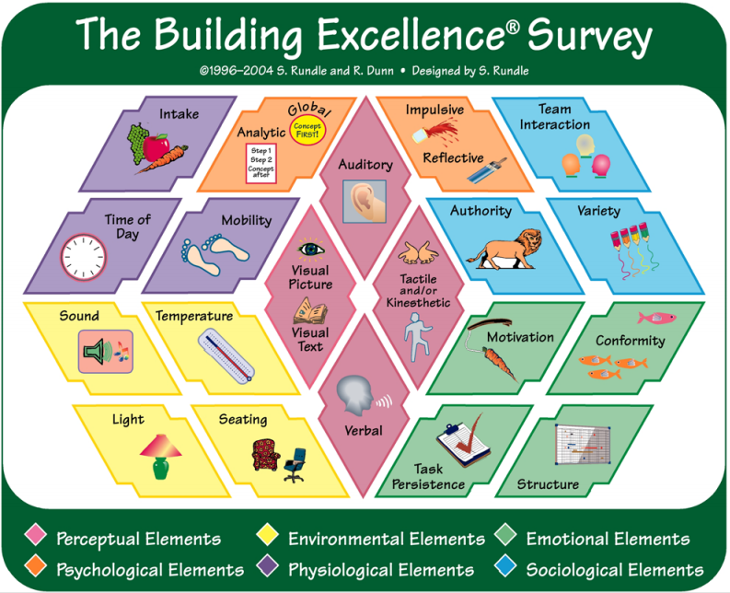
Example2: Rundle and Dunn Model
Notes:
Those are the 26 elements.
are classified into 6 categories, having different colors in this graph: Perceptual, Environmental, Emotional, Psychological, Physiological and sociological.
Intake: Do you focus best when you snack while you study or after you are finished?
Time of the Day: At what time of the day are you most effective and efficient:
Early Morning?
Late Morning/Early Afternoon? Late Afternoon?
Evening?
Mobility: When you stay in one place for too long, do you become restless?
---------------------
Sound: Do you concentrate best with sound in the background or a in quiet environment?
Light: Do you study best when the lights are bright or soft and indirect?
Temperature: Do you concentrate and stay focused longer when the temperature is warmer or cooler?
Seating: Do you concentrate best when sitting at a desk with a straight-backed chair or more informal seating?
-------------------------
Team Interaction (work): Are you more productive when you work alone or with one other person, in a small group , or in a large team?
Authority: Do you work well with a person who is an expert in his field?
Or Are you less effective when someone is looking over your shoulder when you work or study?
Varity (routine): Do you prefer routine work using proven methods?
Or Do you become bored when you have to do the same thing over and over?
---------------
Motivation (self, external): Positive feedback from others (externally motivated)
Or Positive feedback from yourself (internally motivated)
Conformity (ur way, others way): Do you prefer to do things the way you think they should be done?
Or Do you prefer to do things the way others think they should be done?
Task Persistence (one-by one tasks, several): Do you prefer completing one task before beginning another?
Or Do you prefer to work on several tasks at the same time?
Structure (by u or others): Do you like others to provide procedures for you to follow?
Or Do you prefer to create your own procedures?
-----

Slide 19
Perceptual Elements

Slide 20
Perceptual Elements
Visual Picture
Visual Text
Tactile and/or Kinesthetic
Auditory
Verbal
LISTEN
SEE
READ
DOING
DISCUSS
Notes:
Auditory Learners: Remember best when they LISTEN to a lecture, a presentation, or an audiotape
Visual Picture Learners: Remember best when they SEE (create) mental images more than of what they hear or read.
Visual Text Learners: Remember best when they READ the written word (textbooks, memos).
Tactile and/or Kinesthetic Learners: Remember best by DOING rather than sitting and listening, reading, or thinking about the information.
Verbal Learners: Remember best when they DISCUSS with others the new and complex information they are learning.

Slide 21
Psychological Elements

Slide 22
a. Reflective / Impulsive
Reflective
Take time to weigh their options before making decisions and solving problems.
When taken to the extreme, this approach leads to analysis paralysis!
Impulsive
Prefer less detail when making decisions and solving problems.
When taken to the extreme, impulsive people want others to be brief, and be gone!
© NetDansk

Slide 23
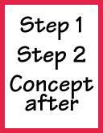
b. Analytic / Global
Analytic
Process information best when it is presented sequentially and the information builds toward a conceptual understanding.
Global
Process information best when humor and metaphors are used and they need to understand the concept before the details make sense.
© NetDansk

Slide 24
Some Validity Studies
Study (1): Validity of Index of Learning Styles.
Study (2): Criticism: Pashler et al. (2008).
Study (3): Criticism: Massa & Mayer, (2006).
Study (4): Testing the Cognitive Theory of Multimedia
Learning.

Slide 25
1- Validity of Index of Learning Styles
“A Study of the Reliability and Validity of the Felder-Soloman Index of Learning Styles” by T. Litzinger et al.
Students from 3 colleges: engineering, liberal arts and education.
ILS is appropriately matched to the intent of the scales, providing evidence of validity for the instrument.
The reliability estimate based on Cronbach alphas ranged from 0.56 to 0.77.
"Applications, Reliability, and Validity of the Index of Learning Styles" by R. Felder et al.
Presented several studies on the validity of ILS.
Alphas coefficient greater than 0.5 for most studies
Notes:
Cronbach's alpha: is a coefficient of reliability. It is commonly used as a measure of the internal consistency or reliability of a psychometric test score for a sample of examinees.
Tuckman suggests that appha greater than or equal 0.75 is acceptable for instruments that measures achievements, and greater than or equal 0.5 for instruments that measures attitude.
.5 < α Unacceptable

Slide 26
2- Criticism: Pashler et al. (2008)
Learning Styles Hypothesis → preferences
Meshing Hypothesis → presentation should mesh with the learner’s preference
Provides criteria to design studies that provide evidence for Learning Styles.
Results:
Learning Styles preferences exist with no dispute
BUT no evidence (according to their criteria) for the Meshing Hypothesis
Notes:
“Our review of the literature disclosed ample evidence that children and adults will, if asked, express preferences
about how they prefer information to be presented to them. There is also plentiful evidence arguing that people differ
in the degree to which they have some fairly speciﬁc aptitudes for different kinds of thinking and for processing different types of information. However, we found virtually no evidence for the interaction pattern mentioned above, which was judged to be a precondition for validating the educational applications of learning styles. Although the literature on learning styles is enormous, very few studies have even used an experimental methodology capable of testing the validity of learning styles applied to education. Moreover, of those that did use an appropriate method, several found results that ﬂatly contradict the popular meshing hypothesis.” from Pashler et al., 2008

Slide 27
3- Criticism: Massa & Mayer, (2006)
“Testing the ATI hypothesis: Should multimedia instruction accommodate verbalizer-visualizer cognitive style?” by L. Massa, R. Mayer, 2006
Results:
Support for the verbalizer-visualizer hypothesis
No support for the attribute-treatment interaction ATI hypothesis
Conclusion: There was not strong support for the hypothesis that verbal learners and visual learners should be given different kinds of multimedia instruction
Notes:
“College students (Experiment 1) and non-college adults (Experiment 2) studied a computer-based 31-frame lesson on
electronics that offered help-screens containing text (text group) or illustrations (pictorial group), and then took a learning test.
Participants also took a battery of 14 cognitive measures related to the verbalizer-visualizer dimension including tests of cognitive
style, learning preference, spatial ability, and general achievement. In Experiment 3, college students received either both kinds of
help-screens or none. Verbalizers and visualizers did not differ on the learning test, and almost all of the verbalizer-visualizer
measures failed to produce significant attribute x treatment interactions (ATIs). There was not strong support for the hypothesis that verbal learners and visual learners should be given different kinds of multimedia instruction.” Massa and Mayer, 2006

Slide 28
Cognitive Theory of Multimedia Learning
Notes:
The right column of the ﬁgure represents the auditory-verbal channel and the left column the
visual-pictorial channel.
Words enter the cognitive system through the ears (if the words are spoken), or through the eyes if written, and pictures enter though the eyes.
the learner pays attention to some of the words, yielding the construction of some word sounds in working memory. Also, the learner pays attention to some aspects of the pictures, yielding some images in working memory.
In the cognitive process of organizing words, the learner mentally arranges the selected words into a mental representation in working memory that we call a verbal model. Similarly, the learner mentally arranges the selected images into a mental representation that we call a pictorial model.
In the cognitive process of integrating, the learner mentally connects the verbal and pictorial models, as well as appropriate prior knowledge from long-term memory.
In education, verbal modes of instruction have traditionally played a larger role than pictorial modes of instruction.
1- Verbal modes of instruction
are based on words and include spoken text (such as lectures and discussions)
and printed text (like text in textbooks or on-screen text).
2- Pictorial modes of instruction are based on pictures and include static
graphics (such as photographs, illustrations, ﬁgures, and charts) and
dynamic graphics (such as animation and video).

Slide 29
4- Testing Cognitive Theory of Multimedia
Principle | # of Tests
1. Multimedia principle: Deeper learning from verbal explanation and pictures than from verbal explanation alone. | 3
2. Contiguity principle: Deeper learning from presenting words and pictures simultaneously rather than successively | 8
3. Coherence principle: Deeper learning when extra words, sounds, or pictures are excluded rather than included | 4
4. Modality principle: Deeper learning when words are presented as narration rather than as on-screen text | 4
Notes:
examine eight predictions, some of which conﬂict with common sense, that can be derived from the cognitive theory of multimedia learning.
First three principles → concise narrated animation

Slide 30
4- Testing Cognitive Theory of Multimedia
Principle | # of Tests
5. Redundancy principle: Deeper learning when words are presented as narration rather than as both narration and on-screen text | 2
6. Personalization principle: Deeper learning when words are presented in conversational style rather than formal style | 2
7. Interactivity principle: Deeper learning when learners are allowed to control the presentation rate | 1
8. Signalling principle: Deeper learning when key steps in the narration are signalled (verbally) rather than nonsignaled | 1
Notes:
Personalized: in a conversational style, using first and second-person rather than third person
Signaled == emphasized

Slide 31
Conclusions
The existence of Learning Styles preferences is not in dispute.
No clear evidence for the Meshing Hypothesis: presentation should mesh with the learner’s preference.
Interesting results from the cognitive theory of Multimedia learning:
Narrated Animation
Concise
Key ideas emphasized
Personalized
Interactivity

Slide 32
References
Felder, R.M. and Silverman, L.K., "Learning and teaching styles in engineering education", Engineering education 78, 7 (1988).
Mayer, R.E., "Cognitive Theory and the Design of Multimedia Instruction: An Example of the Two-Way Street Between Cognition and Instruction", New directions for teaching and learning 2002, 89 (2002).
Massa, L.J. and Mayer, R.E., "Testing the ATI hypothesis: Should multimedia instruction accommodate verbalizer-visualizer cognitive style?", Learning and Individual Differences 16, 4 (2006).
Pashler, H. McDaniel, M. Rohrer, D. and Bjork, R., "Learning styles concepts and evidence", Psychological science in the public interest 9, 3 (2008).
Dunn, R.S. and Dunn, K.J., Teaching students through their individual learning styles: A practical approach., (1978).
Felder, R.M. and Spurlin, J., "Applications, reliability and validity of the index of learning styles", International Journal of Engineering Education 21, 1 (2005)
Coffield, F. and others, "Learning styles and pedagogy in post-16 learning: A systematic and critical review", (2004).

Slide 33
Thanks
Questions?

