Slide 1
WeTextbook Reader
Joseph G. Tront
John Cristy
Virginia Tech

Slide 2
Goals
To implement an e-Textbook Reader with as much capability as possible for any content using existing software and hardware
To help bridge textbook and lecture content through note taking

Slide 3
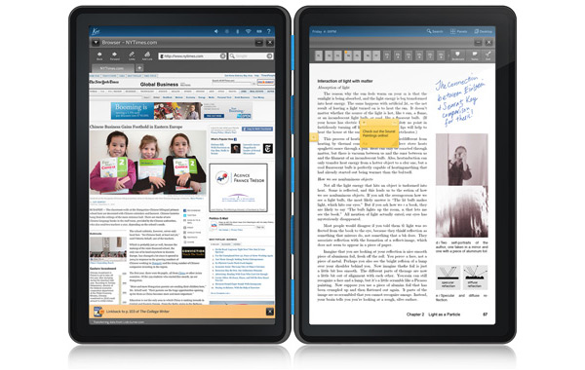
Previous Work
Kno Tablet
2 14.1” touch screens
SDK for applications
Cancelled in April 2011
Others (CourseSmart, Kno, etc.)
Some Multimedia
Similar to PDFs
DRM Issues
Require constant Internet Connection

Slide 4
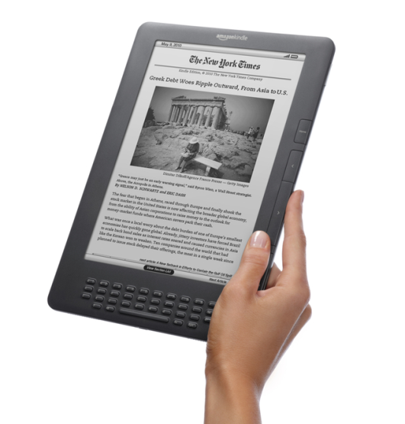
Kindle DX Case Study at Reed College
Successes
Problems
Legibility of Screen
Form Factor
Durability
Distribution System
Missing PDF capabilities
Content Acquisition
Poor Multimedia
Slow Page Turning
Page Navigation
Difficulty of taking notes

Slide 5
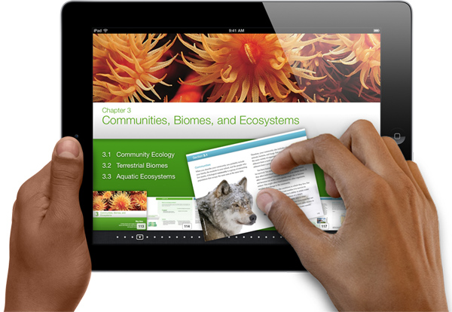
Latest: Apple’s iPad Textbook
3D Images
Multi-Touch Gestures
Searching for Content
Interactive Quizzes
Auto-Generated study cards
iTunes U
Authoring tools

Slide 6
Note Taking
A higher quantity of notes correlates with higher achievement (Kiewra 1988)
Small Screens and poor interfaces reduce the number of notes taken by students (Kim 2009)

Slide 7
Ideas from WIPTE 2010
Electronic notes; stylus enabled
Multimedia
Search on e-ink
Individualized Tutoring
Collaboration
Bookmarks
Voice Recognition

Slide 8
Development Process
Address Problems and maintain successes from prior attempts
Test solution in the classroom (Future)
Choose Platform for quick development: OneNote and Windows

Slide 9
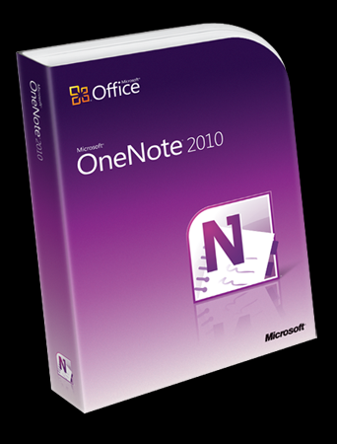
Why OneNote?
Book like page organization
Flexible Note taking
Platform Ubiquity
Developer API

Slide 10
Features
Linked Split Screen
Window Focus Change on Hover
Gestures for navigation and bookmarking
Bookmarked pages for quick returning
Navigation Buttons to save screen real estate
Search to Web
Bluetooth Scanner
Simple Quiz System
Importer for Publisher

Slide 11
Side-by-Side Pages
Horizontally or Vertically Tiled
Synchronized or independent

Slide 12
Focus Change
Multi-Window tap first then write problem
Mouse/Stylus Hover
Change focus before user tries to write

Slide 13
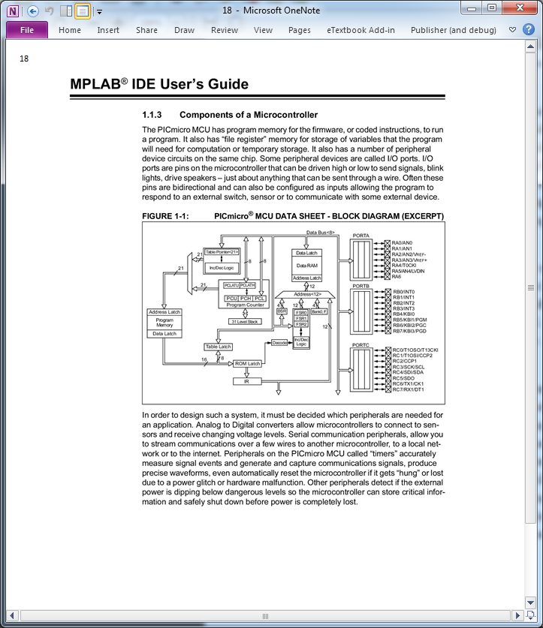
Gestures
Retain standard gestures like panning and pinch to zoom
Bookmark
View Bookmarks
Swipe to change pages

Slide 14
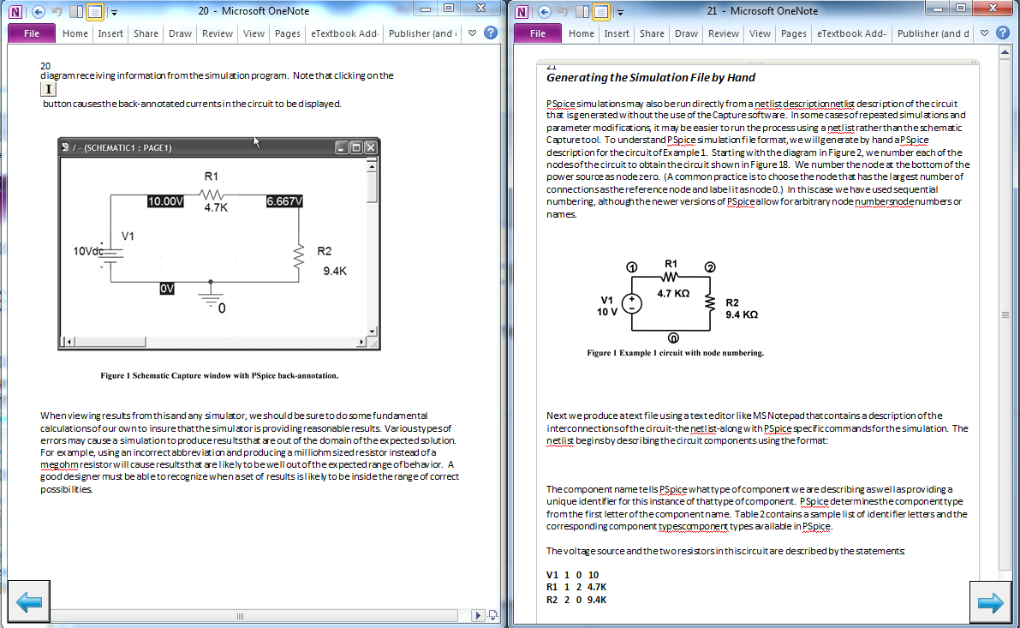
Navigational Buttons

Slide 15
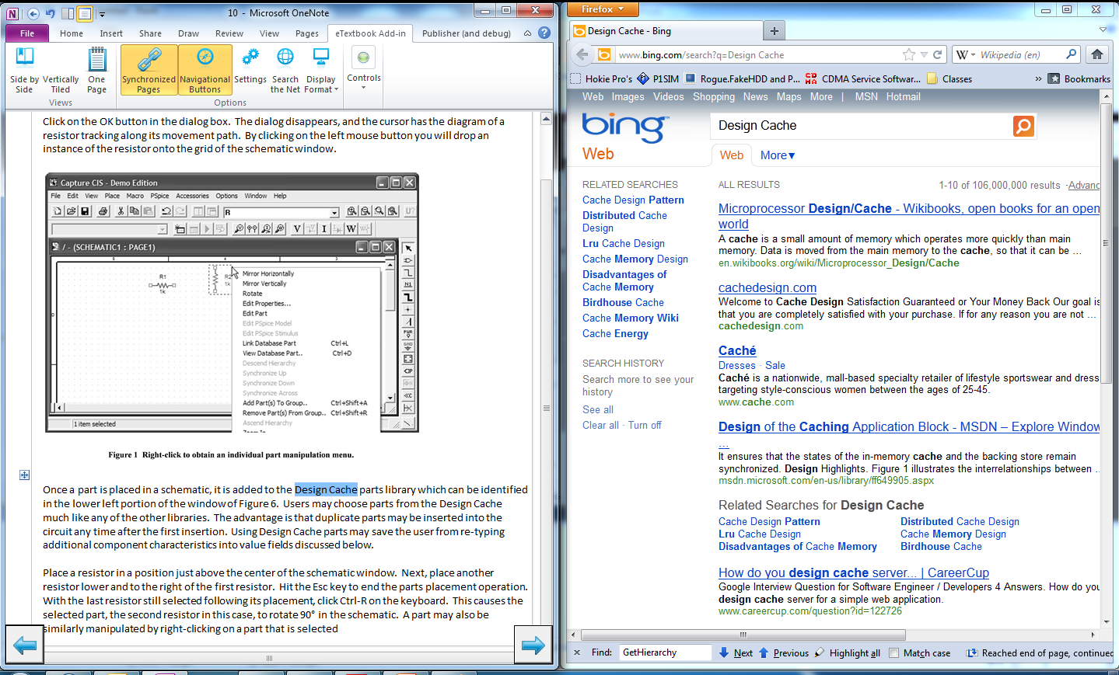
Search the Web

Slide 16
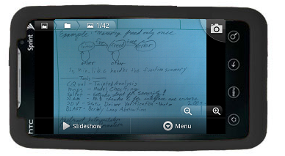
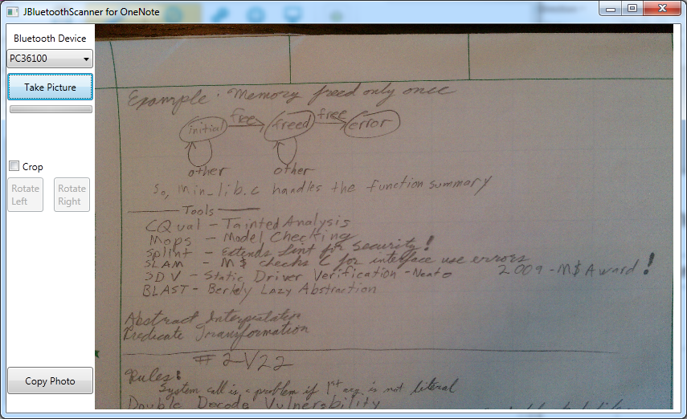
Bluetooth Scanner
Use Android Phone to scan documents into notes

Slide 17
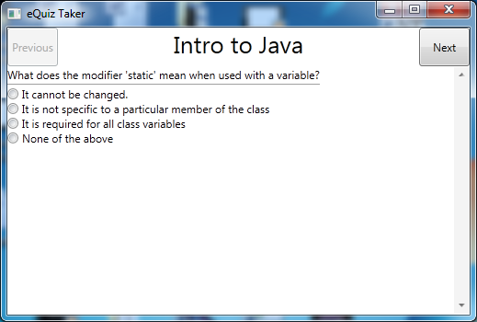
Built-in Quizzing
While hyperlinks can lead to more complex systems, the add-in includes a simple system meant for review

Slide 18
File Importer
Import files from PDF and RTF
Each page in the source file becomes one page in OneNote
PDFs come in as images
RTF content remains in native form (text is text, etc.)

Slide 19
Other Considerations
Notebook sharing can allow students to collaborate
Microsoft’s Office Live allows for cloud storage allowing Books to be viewed with the OneNote Apps for Android and iOS
With Interactive Classroom lecture notes can be inserted into the textbook
File embedding for any multimedia needs

Slide 20
Next Step
Perform a formal evaluation of the tool

Slide 21
Questions?

Slide 22
Developing a OneNote Add-in
.NET
Custom Office Ribbon Controls
Windows API’s
OneNote API
GhostScript
Deployment
Malte Ahren’s Tutorial

Slide 23
Software Modules of the Add-in
Textbook Import
Window Manipulation
Page Controls
Gestures
Web Search
Quizzing
Mobile Scanner

Slide 24
Textbook Import
PDF
RTF
Images of “Printout”
Uses Ghostscript and GhostScript Wrapper
One Page of PDF = One Page in OneNote
Preserves Content Format
Uses “RTF Dom Parser”
Shape Rasterization
Use the OneNote API’s to insert page content

Slide 25
OneNote XML
Notebook Hierarchy
Lists the open Books, Sections, and Pages
Page Content
Lists every item on the page, such as Text, Ink, and images
Both Accessible through the OneNote API

Slide 26
Window Manipulation
Horizontal and Vertical Tiling
Window Handles
User32.DLL
Get and Set window parameters
Page Changes
Focus Change on Hover

Slide 27
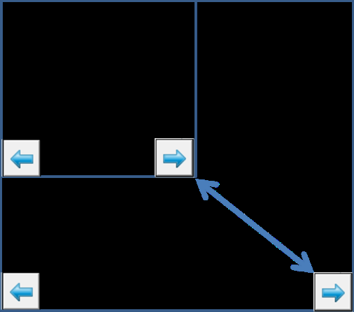
Page Controls/Navigation
Windows Forms
User32.dll
Updating

Slide 28
Gestures
Windows Hooks
System Events
User32.dll
Low-Level Mouse
Mouse/Stylus/ Touch
Time Constraint
Bookmark
Swipe to change pages

Slide 29
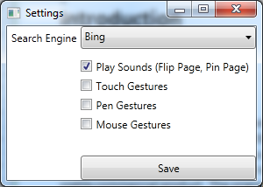
Settings/Configuration
WPF (Windows Presentation Framework
Saved as XML

Slide 30
Web Search
No OneNote API to get highlighted text
Clipboard workaround
Save -> Use -> Restore
New process with URL
Default Browser

Slide 31
Quizzing
Separate .NET/WPF Program
File Type Association
Double-Click in OneNote to open

Slide 32
Mobile Scanner (Windows)
Non-Modal Window
Separate Thread
Bluetooth Communication
RFCOMM
32Feet.NET
Clipboard
Interaction

Slide 33
Mobile Scanner (Android)
Service Discovery Protocol (SDP)
Similar to IP ports
Listens for Command
Camera Takes Photo
Auto-Focus
Steady Photo
Sends JPEG back

Slide 34
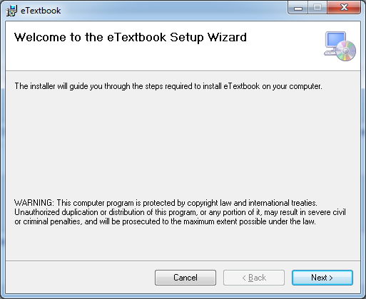
Deployment
ClickOnce Deployment
Easy Add-in Deployment
Not Available for OneNote
Standard Windows Installer

Slide 35
Development Environment
Visual Studio 2010
C#
The main Add-In
Eclipse
Java
Scanner App for Android

Slide 36
Project Details
1 year of development
Approximately 4000 new lines of code
Installer Size is 20.8 MB
Installed Size is 33.1 MB

Slide 37
References
Kno (2012). Retrieved from www.kno.com
T. Marmarelli (2010). The Reed College Kindle Study. Retrieved from https://reed.edu/cis/about/kindle_pilot/Reed_Kindle_report.pdf
iBooks textbooks for iPad (2012) Retreived from http://www.apple.com/education/ibooks-textbooks/
K.A. Kiewra, S.L. Benton, The Relationship Between Information-Processing Ability and Notetaking, Contemporary Educational Psychology, Volume 13, Issue 1, January 1988, Pages 33-44, ISSN 0361-476X, 10.1016/0361-476X(88)90004-5.
K. Kim,, S. Turner,, & M. Pérez-Quiñones, (2009). Requirements for electronic note taking systems: A field study of note taking in university classrooms. Education & Information Technologies, 14(3), 255-283. 10.1007/s10639-009-9086-z
J. Tront (2010). Operations Needed in e‐Textbooks of the Future. Retrieved from http://filebox.ece.vt.edu/~jgtront/wipte/e_textbook_functionality.pdf
Microsoft Interactive Classroom (2011). Retrieved from http://www.educationlabs.com/Projects/ic/Pages/default.aspx

Slide 38
References
“OneNote Developer Reference.” Internet: http://msdn.microsoft.com/en-us/library/ff925947.aspx, Feb. 2011 [Feb. 18 2012].
M. Ahrens “Developing OneNote 2010 Add-Ins.” Internet: http://www.malteahrens.com/#/blog/howto-onenote-dev/, [Feb. 18 2012].
“Ghostscript, GhostView and GSView” Internet: http://pages.cs.wisc.edu/~ghost/, Jan. 23 2012 [Jan. 30 2012].
M. Ephraim “A Simple C# Wrapper for Ghostscript.” Internet: http://www.mattephraim.com/blog/2009/01/06/a-simple-c-wrapper-for-ghostscript/, Jan 6 2009 [Jan. 30 2012].
“RTF DOM Parser.” Internet: http://sourceforge.net/projects/rtfdomparser, Oct. 13 2010 [Dec. 13 2011].
“32feet.NET – Personal Area Networking for .NET”

